Slide 1
NOURISHING
TRADITIONAL DIETS
THE KEY TO VIBRANT HEALTH
Part II
How to Change Your Diet for the Better
BY SALLY FALLON MORELL, PRESIDENT
THE WESTON A. PRICE FOUNDATION
Copyright 2018 Sally Fallon Morell
POWERPOINT DESIGN, AS WELL AS SOME STUDIO PHOTOGRAPHY,
BY SANDRINE HAHN
Notes:
This presentation is copyrighted 2018 by Sally Fallon Morell. Others may use these slides to present this information without permission to the public, as long as the presentation is given without compensation; however, this presentation may not be sold or given for pay.

Slide 2
DISCLAIMER
Title Slide
The information contained in this presentation
is not intended as a substitute for professional
medical advice, diagnosis or treatment.
It is provided for educational purposes only.
You assume full responsibility for how you choose
to use this information.
Notes:
This presentation is copyrighted 2010 by Sally Fallon Morell. Others may use these slides to present this information to the public without compensation; however, this presentation may not be sold or given for pay.

Slide 3
1. MAKE YOUR OWN SALAD DRESSING
Notes:
The first step to take in changing your diet for the better is to make your own salad dressing. This simple step will not only greatly improve the quality of the food you eat, it is also the first step in becoming a great cook!

Slide 4
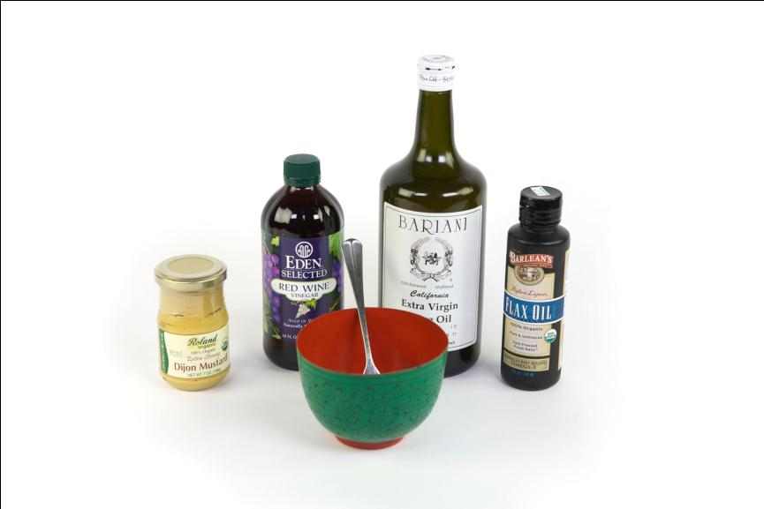
Salad Dressing 1
RAW VINEGAR
COLD-PRESSED OLIVE OIL
GOOD QUALITY MUSTARD
EXPELLER-EXPRESSED FLAX OIL
Notes:
To make basic salad dressing, you need four ingredients: good quality mustard, raw vinegar (such as wine vinegar, apple cider vinegar, rice vinegar or balsamic vinegar); cold-pressed olive oil and a very small amount of expeller-expressed flax oil. Check the Weston A. Price Foundation Shopping Guide for recommended brands.

Slide 5
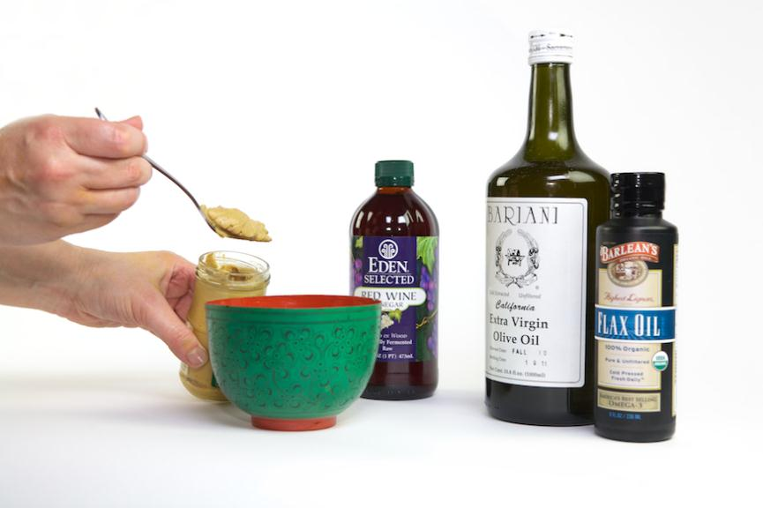
Salad Dressing 2
Notes:
First, dip your fork in the mustard.

Slide 6
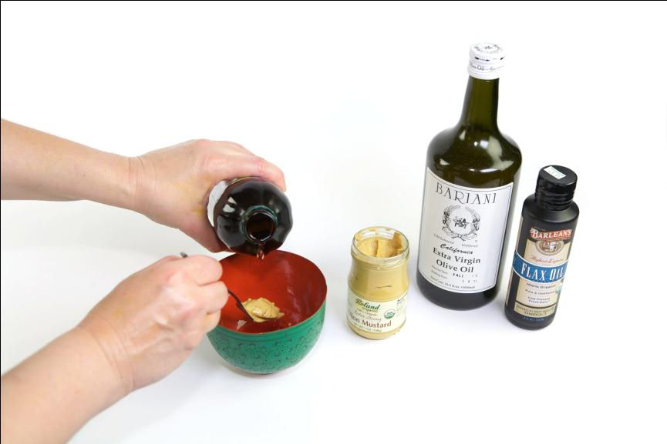
Salad Dressing 3
Notes:
Second, add a little vinegar.
At first you may have to measure, but soon you will be able to do this without measuring. In general, for a generous salad for two, use 1 tablespoon vinegar and 4 tablespoons olive oil (a ratio of four to one).

Slide 7
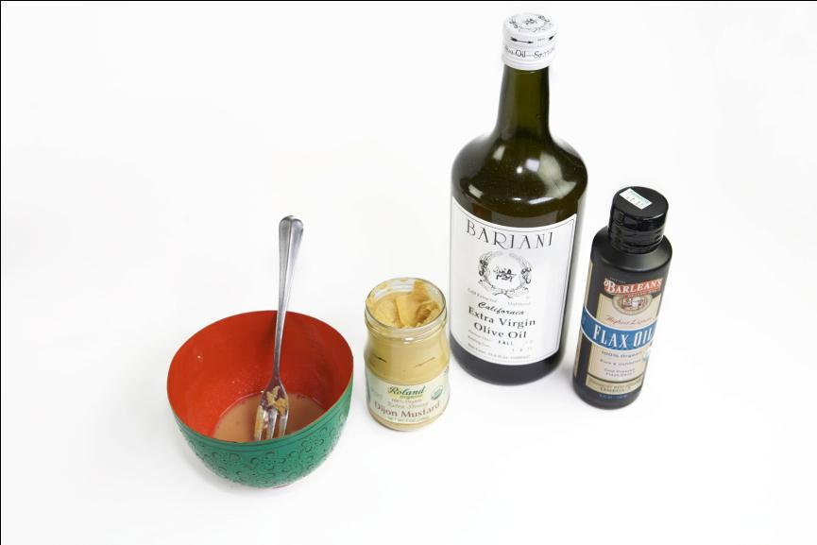
Salad Dressing 4
Notes:
Now you are ready to add the oils.

Slide 8
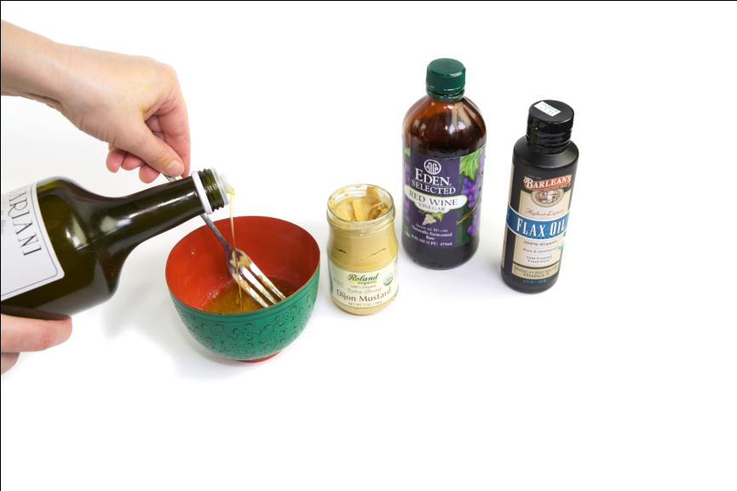
Salad Dressing 5
Notes:
First, slowly add the olive oil while stirring. This process will form an emulsion—a thick, creamy dressing—without the use of thickeners or additives.

Slide 9
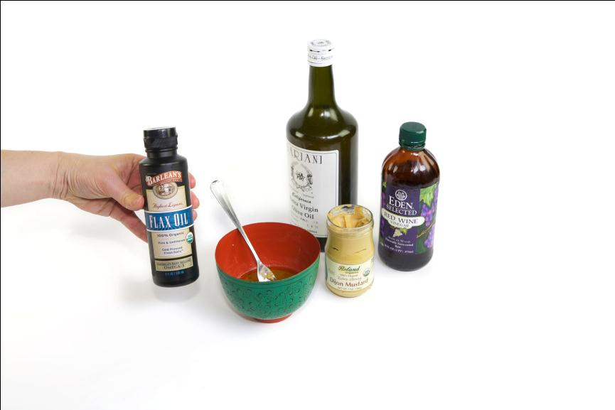
Salad Dressing 6
Notes:
The next step is to add a little flax oil—just a half teaspoon or so. There is an important reason to add flax oil, and an equally important reason not to add too much.

Slide 10
FATTY ACID PROFILE OF FLAX OIL
Notes:
The reason we add a little flax oil is because flax oil is a natural source of omega-3 fatty acids. Remember that we need to redress the imbalance of omega-6 and omega-3 fatty acids. We do this by eliminating all the commercial vegetables oils (high in omega-6) from our diet, and adding a little flax oil to our salad dressing.
But don’t overdo! Several people in the health field are promoting the over-consumption of flax oil. It is possible to have an imbalance with omega-3’s as well as with omega-6’s. Just a half teaspoon in the salad dressing will suffice.
And remember, flax oil is very fragile. Always store it in the refrigerator and never heat it. The brands we recommend are Omega and Barleans.

Slide 11
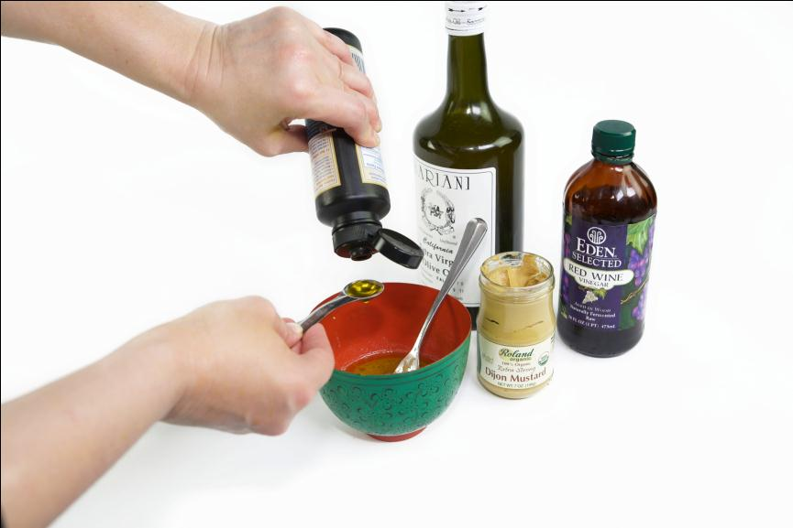
Salad Dressing 7
Notes:
Once you add your flax oil, and mix again with the fork, your basic salad dressing is ready. It takes less than one minute to make.
There are many ways to dress up this basic dressing—you can add herbs, cream, egg yolks, garlic, tomato paste or anchovy paste. You can toss it in the blender with blue cheese and cream and voila! Creamy blue cheese dressing. Mix the basic dressing with cream, mayonnaise and curry powder and you have curried dressing for chicken salad.

Slide 12
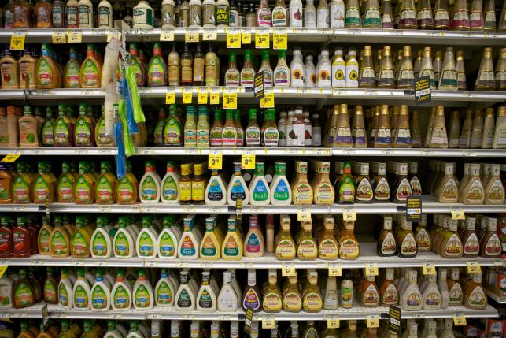

COMMERCIAL SALAD DRESSINGS
BAD, RANCID OILS + BAD ADDITIVES = HEALTH CRISIS
Notes:
It is so easy to make your own salad dressing, but most people use ready-made commercial dressings, which are a nutritional disaster.

Slide 13
SALAD DRESSING COMPARISON
HOMEMADE DRESSING
Extra Virgin Olive Oil
Stable Oleic Acid
Vitamin E
Antioxidants
Vanadium
Expeller Expressed
Flax Seed Oil
Omega-3 EFAs
Vitamin E
Antioxidants
Cost about $1.50 per cup
COMMERCIAL DRESSING
Processed Vegetable Oils
Mostly Rancid Omega-6,
Trans Fatty Acids,
Free Radicals, Polymers,
Cyclic Compounds,
Aldehydes, Ketones,
Epoxides
Preservatives
Additives
Flavorings
Cost about $1.50 per cup
Notes:
The column on the left shows what we will have in our homemade salad dressing. Olive oil is stable and contains vitamin E, anti-oxidants and vanadium. Vanadium is a mineral that is very protective of the heart.
Flax oil provides omega-3 fatty acids, vitamin E and anti-oxidants.
By contrast, commercial salad dressings are made with cheap vegetable oils full of free radicals and dangerous breakdown products. They are also loaded with artificial flavorings and additives.
Surprisingly, it costs no more to make your own salad dressing, using the finest ingredients, then it does to purchase ready-made dressing.

Slide 14
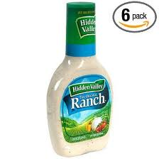
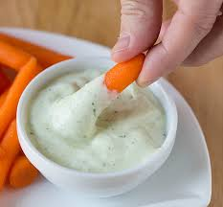
RANCH DRESSING
STORE BOUGHT
Vegetable oil (soybean and/or canola) water, egg yolk, sugar, salt, cultured nonfat buttermilk, natural flavors, spices, vinegar, phosphoric acid, xanthan gum, modified food starch, monosodium glutamate, artificial flavors, disodium phosphate, sorbic acid, calcium disodium EDTA, disodium inosinate, disodium guanylate
HOMEMADE
Buttermilk,
mayonnaise,
sour cream,
parsley, chives, garlic
vinegar or lemon juice
salt and pepper
Notes:
Look at the ingredient list for store bought ranch dressing. So much better to make your own. And if you use homemade buttermilk, you will have a probiotic dressing.

Slide 15
REDRESSING THE OMEGA-6/OMEGA-3 IMBALANCE
ELIMINATE all commercial vegetable oils
from the diet.
USE FLAX OIL, a source of omega-3 fatty acids, in SMALL amounts in salad dressing (about ½ teaspoon per day).
CHOOSE ORGANIC AND GRASS-FED animal and plant foods for a good source of omega-3 fatty acids.
Notes:
We spoke earlier about the excess of omega-6 fatty acids in the modern American diet. This is easy to remedy. First and foremost, eliminate all commercial vegetable oils, which are composed largely of omega-6 fatty acids.
Second, use a small amount of flax oil in your salad dressing.
And finally, choose organic and pasture-fed animal and plant foods, which will be sources of additional omega-3 fatty acids.

Slide 16
FATTY ACID PROFILES OF
POLYUNSATURATED OILS
Notes:
This is where we get all those polyunsaturated fatty acids, in vegetable oils used in cooking, salads and added to processed foods. Actually, these oils are usually “winterized,” which means that manufacturers remove most of the saturated and monounsaturated fatty acids, making them almost purely omega-6 polyunsaturated.

Slide 17
Canola Oil
CANOLA OIL – A NEW FANGLED OIL
A NEW OIL CREATED BY GENETIC MANIPULATION FROM THE RAPE SEED.
FATTY ACID PROFILE:
07 percent SATURATED
65 percent MONOUNSATURATED
19 percent OMEGA-6
09 percent OMEGA-3
Seemingly "heart healthy.”
Increases the body’s need for vitamin E
Causes heart lesions in test animals
Increases platelet clumping and causes deaths in stroke-prone rats.
Source: The Great Con-ola, westonaprice.org.
Notes:
What about canola oil? The industry developed canola oil when they realized that the polyunsaturated oils could not be used in foods for the health conscious consumer—the evidence that they caused cancer was just too great. They needed a monounsaturated oil, like olive oil. But olive oil is expensive and there is not enough on the world markets for inclusion in processed food. So the industry went in search of a cheap monounsaturated oil.
They thought that canola oil would be just the ticket, a very heart-healthy oil with a fatty acid profile high in monounsaturated fatty acids, very low in saturates and also containing some omega-3. However, when fed to test animals, the animals developed heart lesions, vitamin E deficiency, increased platelet clumping and increased death in stroke-prone rats. So canola oil is not at all heart-healthy as claimed. By the way, these problems cleared up when the animals were given saturated fats along with the canola oil.
An additional problem is that the omega-3 fatty acids become rancid during processing so the oil needs to undergo a deodorizing process. This process actually gets rid of the omega-3s and creates a small amount of trans fat. Many books suggest consuming canola oil to obtain omega-3 fatty acids, but very few are left after processing. Those that are left in the oil are rancid, full of free radicals. And most canola oil today is genetically modified, so will be heavily sprayed with RoundUp.
If you could obtain some truly organic cold pressed canola oil, it would probably be OK to use it on salads, but to be safe, just stick to olive oil.
For more information on canola oil, see “The Great Con-ola” at www.westonaprice.org.

Slide 18
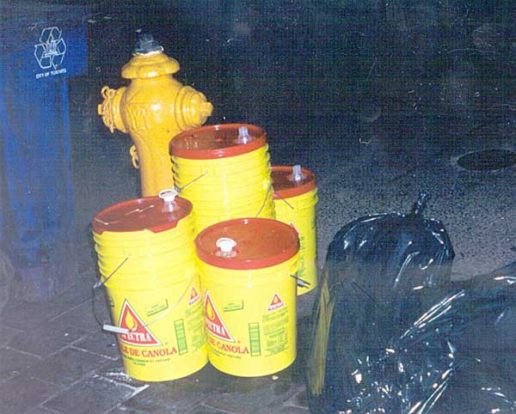
Canola Cans
Notes:
These cans were photographed behind a Chinese restaurant in Toronto. Traditionally Chinese food was cooked in lard or duck fat, but today canola oil is used.

Slide 19
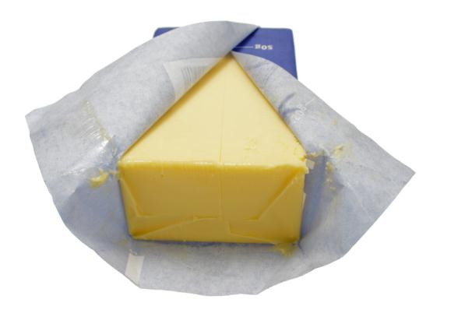
2. SWITCH TO BUTTER - AVOID PARTIALLY HYDROGENATED OILS
... AND SEE THOU HURT NOT THE OIL ... REV. 6:6
Notes:
So the first step (to make your own salad dressing) is easy; and the second one is also easy. . . switch to butter and avoid partially hydrogenated oils.
But what do we mean by a partially hydrogenated oil?

Slide 20
MANUFACTURE of MARGARINE and SHORTENING
SOYBEANS, CORN, COTTONSEED OR
CANOLA SEEDS
OILS EXTRACTED BY HIGH TEMPERATURE
AND PRESSURE
REMAINING FRACTION OF OILS REMOVED WITH HEXANE AND OTHER SOLVENTS
OILS WITH CATALYST SUBJECTED TO HYDROGEN GAS IN A HIGH-PRESSURE, HIGH-TEMPERATURE REACTOR.
OILS MIXED WITH A NICKEL CATALYST
OILS, NOW RANCID, STEAM CLEANED TO REMOVE ALL VITAMINS AND
ANTI-OXIDANTS
(BUT PESTICIDES AND SOLVENTS REMAIN!)
SOAP-LIKE EMULSIFIERS MIXED IN
OIL STEAM CLEANED AGAIN TO REMOVE HORRIBLE ODOR
GRAY COLOR REMOVED BY BLEACHING
ADVERTISING
PROMOTES MARGARINE
AS A HEALTH FOOD
MIXTURE IS PACKAGED
IN BLOCKS OR TUBS
ARTIFICIAL FLAVORS,
SYNTHETIC VITAMINS AND NATURAL COLOR ADDED
Notes:
To answer that question, let’s begin by looking at how margarine and shortening are made.
First, oils are removed from seeds or beans by high temperature and pressure. The remaining fraction of the oil is removed with hexane (so-called “food grade” gasoline) and other solvents. The oil, now rancid, is steam cleaned, a process that removes all the vitamins and anti-oxidants (but the pesticides and solvents remain).
The oil is then mixed with a powdered nickel catalyst and put into a big reactor where it is flooded with hydrogen. During this process, the molecular structure is rearranged. What goes into the reactor is a liquid oil, what comes out is a semi-solid. Actually, what comes out of the reactor looks like gray cottage cheese, and it smells terrible.
So soap-like emulsifiers are mixed in to smooth out the lumps and the oil is steam cleaned again to remove the horrible odor. The gray color is removed by bleaching. At this point the product can be called “pure vegetable shortening.”
To make margarine, artificial flavors and synthetic colors are then added. Regulations do not allow the addition of synthetic color, so margarine is colored with a natural color—isn’t that a comforting thought! Then the product is packaged in blocks or tubs. . . and sold to the consumer as a health food! Because it is so cheap to make, the edible oil industry has billions in profits for advertising, bribing of government officials, and the takeover of university research departments.
The book of Revelations in the Bible was written for something called the “Latter Days.” Many people believe that we live in the latter days. Verse 6:6 of Revelations says: “. . . and see that thou hurt not the oil.” The author of this book had a prophetic vision of how processed oils would destroy our health in the latter days.

Slide 21
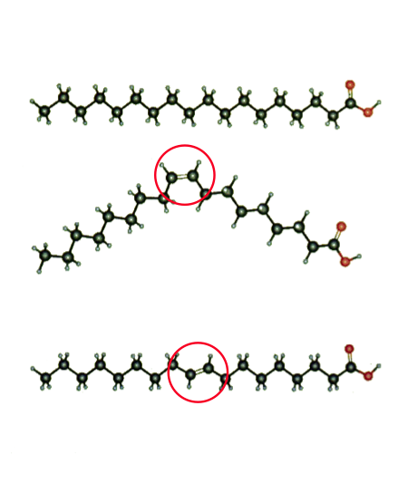
TRANS FATTY ACID
STEARIC ACID
Natural Saturated Fatty Acid
(CIS) OLEIC ACID
Natural Monounsaturated Fatty Acid
(TRANS) ELAIDIC ACID
Unnatural Trans
Fatty Acid
Notes:
How is the molecular structure changed during the partial hydrogenation process? Let’s look at our 18-carbon fatty acids again.
Stearic acid is fully saturated, with 2 hydrogen atoms attached to every carbon atom. Each pair of hydrogen atoms forms an electron cloud, which the body uses for controlled chemical reactions.
Monounsaturated oleic acid is missing two hydrogens, but the remaining two two hydrogen atoms are on the same side, at the bend of the double bond. This is called the cis configuration; the two hydrogen atoms are next to each other and form an electron cloud for controlled chemical reactions.
During the hydrogenation process, one of the hydrogen atoms is moved to the other side so that the hydrogen atoms are now across from each other—this is called the trans configuration (trans means across) and this is what is meant by a trans fatty acid. With the two hydrogen atoms on opposite sides, the molecule straightens out and now has many of the same qualities as a saturate. It will be solid at room temperature and can be used for spreads, for frying and as a shortening in baked goods.
However, in our cell membranes, the trans fat has very different characteristics from a saturated fat or monounsaturated fat. Your body makes chemical reactions where there are electron clouds, but it cannot do this when the cell membrane contains lots of trans fatty acids. With a trans fatty acid, instead of an electron cloud, there is a dead spot, which inhibits enzymes, receptors and hormone production. The more partially hydrogenated oils containing trans fatty acids that you eat, the more trans fats you will have in your cell membranes and the more chaos you will have at the cellular level.

Slide 22
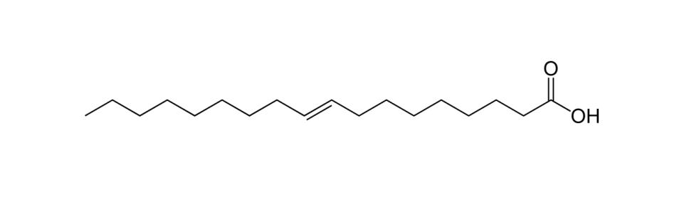
DISEASES CAUSED OR EXACERBATED BY HYDROGENATED TRANS FATS
ATHEROSCLEROSIS AND HEART DISEASE
CANCER
DEGENERATION OF JOINTS AND TENDONS
OSTEOPOROSIS DIABETES
AUTOIMMUNE DISEASES
ECZEMA AND PSORIASIS PMS
LOWERED TESTOSTERONE, LOWERED SPERM COUNT
FAILURE TO GROW LEARNING DISABILITIES
LOW BIRTH WEIGHT BABIES
REDUCED VISUAL ACUITY
REDUCED FAT CONTENT IN MOTHER’S MILK
Notes:
For many years, the industry has claimed that trans fats were harmless, but there is actually a great deal of evidence showing that they contribute to many disease conditions, everything from atherosclerosis to cancer.
Partially hydrogenated trans fats contribute to the degeneration of the joints and tendons, which is why so many people need knee and hip replacements these days.
Trans fats interfere with the insulin receptors in your cells, contributing to type-2 diabetes. Government advice to use margarine instead of butter has led to an epidemic of type-2 diabetes.
When a pregnant woman consumes trans fats, she is more likely to give birth to a low-birth-weight baby. Exposure of the infant to trans fats either in the womb or in the mother’s milk, can interfere with the development of the eyes, resulting in reduced visual acuity.
Finally, trans fatty acids will lower the fat content in mother’s milk, often leading the baby to be fussy (because he is not satisfied) and the mother to give up on nursing. And if she continues, the baby’s development may be compromised.

Slide 23
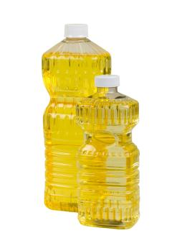
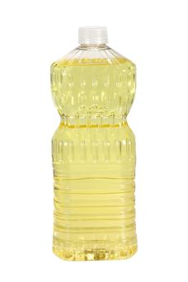
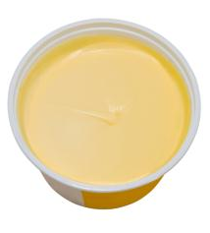
INDUSTRIAL FATS AND OILS
LIQUID POLYUNSATURATED OILS CAUSE UNCONTROLLED REACTIONS IN THE BODY
SOLID PARTIALLY HYDROGENATED OILS INHIBIT REACTIONS IN THE BODY
THE RESULT . . .
BIOCHEMICAL CHAOS
Notes:
The most important first step you can take to improve your health is to remove all industrial fats and oils from your diet!

Slide 24
SATURATED FATS VS. TRANS FATS
 | SATURATED FATS | TRANS FATS
CELL MEMBRANES | Essential for healthy function | Interfere with healthy function
HORMONES | Enhance hormone production | Interfere with hormone production
INFLAMMATION | Suppress | Encourage
HEART DISEASE | Lower Lp(a). Raise "good" cholesterol | Raise Lp(a). Lower "good" cholesterol
OMEGA-3 | Put in tissues and conserve | Reduce levels in tissues
DIABETES | Help insulin receptors | Inhibit insulin receptors
IMMUNE SYSTEM | Enhance | Depress
PROSTAGLANDINS | Encourage production and balance | Depress production; cause imbalances
Notes:
Finally, our government has admitted that trans fats are unsafe at any level. But these spokesmen continue to insist that “trans fats are just as bad as saturated fats.”
However, as you can see from this chart, the saturated fats have the opposite effects compared to the trans fats. The effects of the saturated fats are beneficial while the effects of the trans fats are harmful.

Slide 25
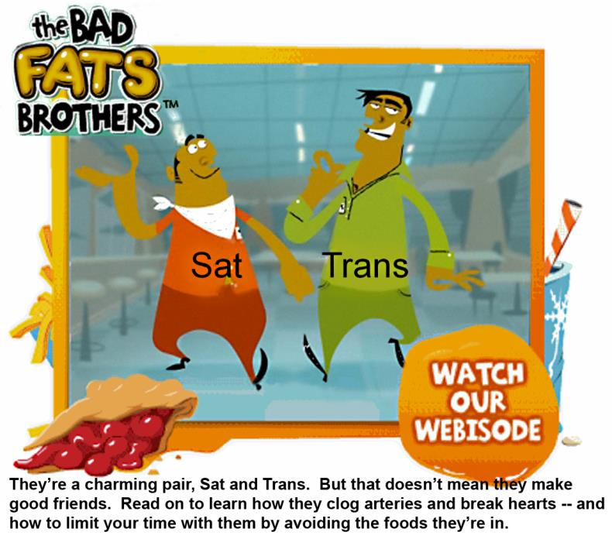
Notes:
The industry has used the bad news about trans fats to continue bashing the saturated fats.

Slide 26
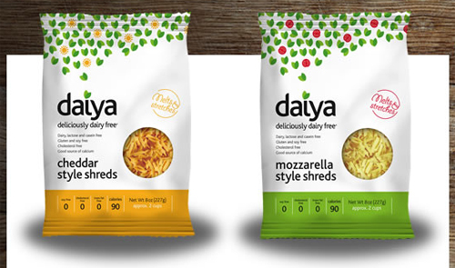
COINCIDENCE?
“New, more realistic
soy imitation cheeses coming to market.”
“Daiya is a delicious, dairy-free vegan cheese product that can melt & stretch just like ‘real’ cheese. The product comes in cheddar and mozzarella as a shredded cheese perfect for nachos, mac & cheese, pizza, lasagna & more.”
Notes:
We read a lot of criticism of cheese, because it contains saturated fat. The industry wants us to use imitation cheese based on soy, of course they demonize the competition.

Slide 27
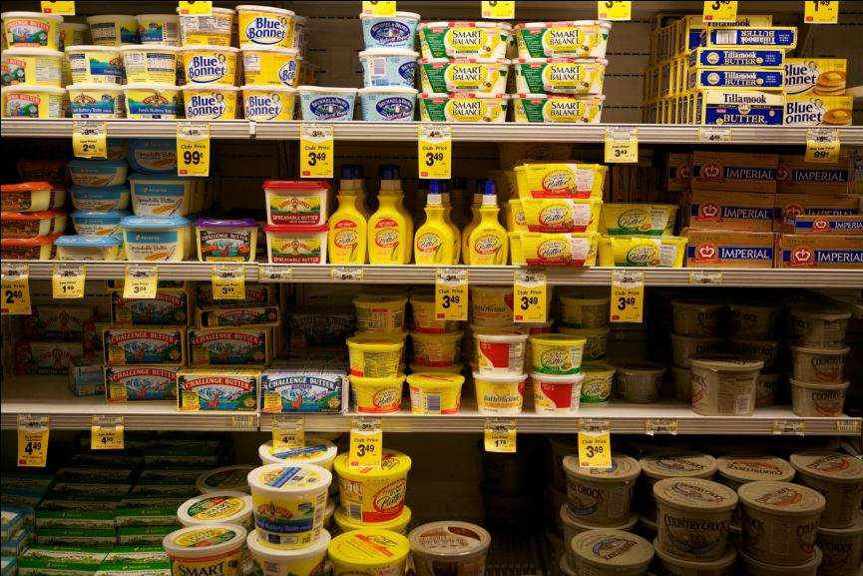
Margarine’s and Spreads
Notes:
This slide illustrates why we have a health crisis in this country. Most of the shelf space in our grocery stores is dedicated to margarines and spreads, with only a few feet of shelf space dedicated to butter.
Now that we have the bad news about trans fats, the industry is pushing the so-called “healthy” spreads that are low in trans fats. But these are made with liquid vegetable oils and contain all sorts of emulsifiers and fillers.
By the way, the low-profit items are put on the lowest or highest shelves. The high-profit items are put on the middle shelves, at eye-level. So you have to reach to the top shelf for the lard and bend down to the bottom shelf for the butter.

Slide 28
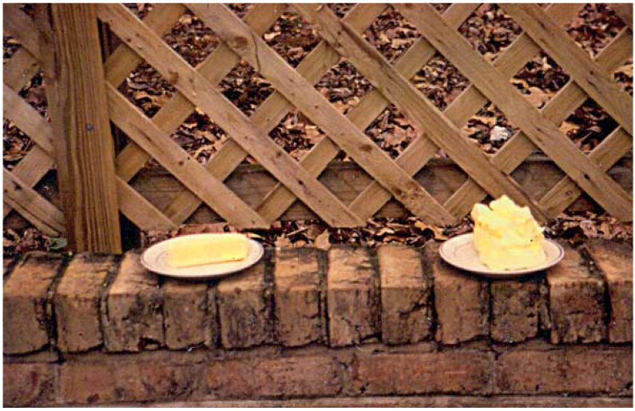
Soft Spread 1
BUTTER
SOFT SPREAD
Notes:
Today most people use “soft spreads,” not margarine. All the health columnists in the major newspapers recommend these “soft spreads,” which are lower in trans fats than margarine.
Here is an experiment I conducted to determine the nutritional quality of soft spreads. I put a stick of butter and a tub of soft spread outside in the garden.

Slide 29
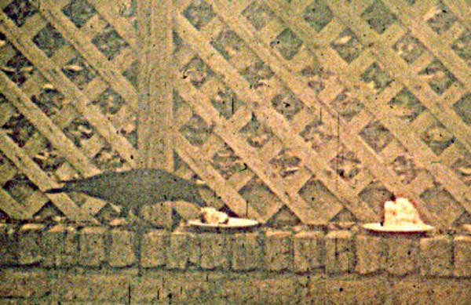
Soft Spread 2
Notes:
A crow came along. He recognized the real food and took a bite of the butter.
I thought that the birds would eat the butter, little by little, and just leave the soft spread.

Slide 30
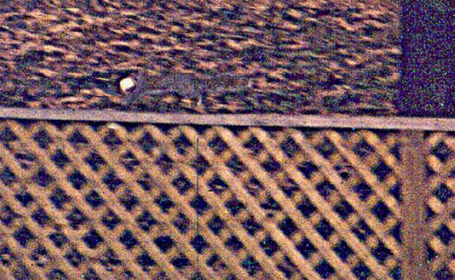
Soft Spread 3
Notes:
But what happened next was that a so-called vegetarian squirrel took the whole stick of butter and ran off with it! The squirrel also wanted real food.
Meanwhile, the soft spread just sat there—the birds and the animals recognized that it was not a food.
So, while low-trans spreads might be a little lower in trans, they are still made out of processed vegetable oils, and they contain all sorts of additives (including soy protein isolate) to make them firm.

Slide 31
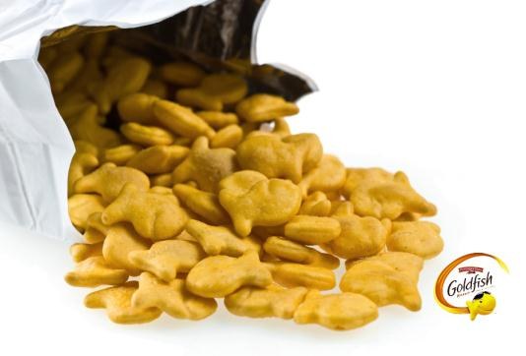
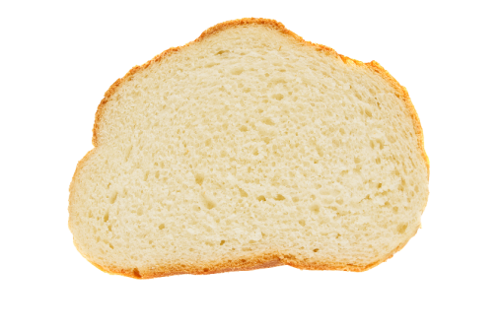
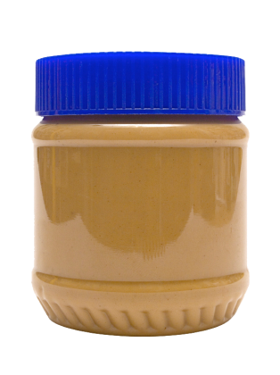


Partially Hydrogenated Vegetable Oils
Notes:
The problem with industrial fats and oils is that they are not limited to margarines and spreads. They are used in most processed foods—crackers, cookies, pastries, cakes and icings, donuts, bread. . .

Slide 32
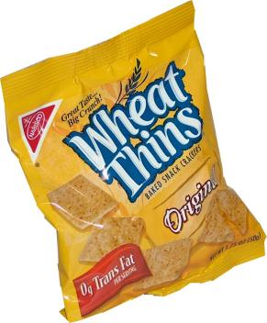
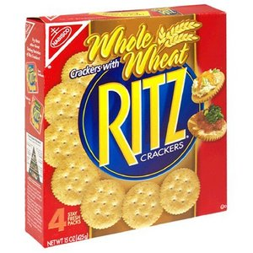
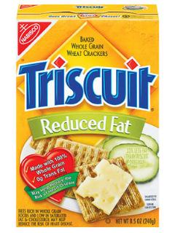
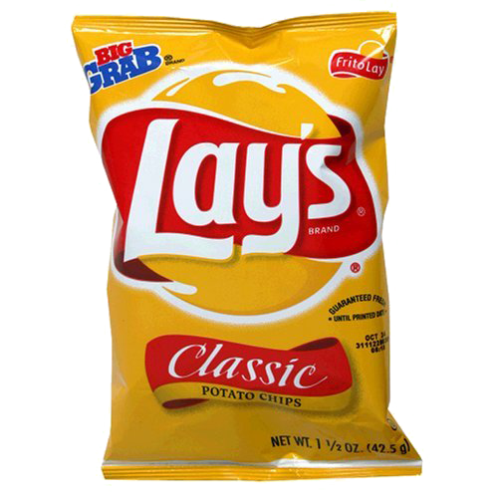
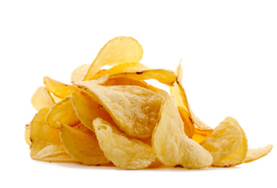
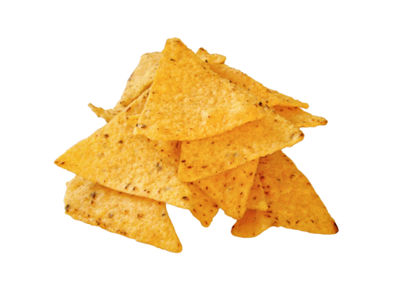
Snack Foods
Notes:
. . . .potato chips, corn chips, popcorn—all popular snack foods with our teenagers. Instead of warning our young people about these effects, the schools are selling these products through vending machines to make money.

Slide 33
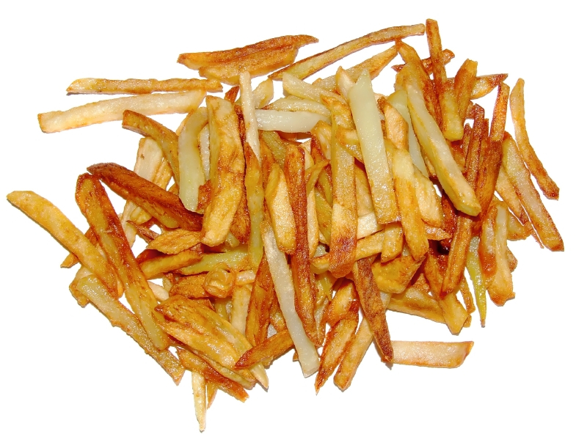
French Fries
Notes:
Fried foods are also loaded with trans fats or, even worse, with liquid polyunsaturated oils, rendered toxic by the frying process.
Up until the mid 1980s, the fast food industry fried potatoes and other foods in beef or lamb tallow, a stable and healthy fat.
The industry switched to partially hydrogenated vegetable oil after a group called Center for Science in the Public Interest (CSPI) carried out some widely publicized demonstrations in front of McDonald’s, protesting against saturated fats and cholesterol. Overnight the industry switched to vegetable oils.
In their magazine, CSPI thanked the soy industry for their support in the campaign. Is CSPI really a front for the vegetable oil industry?
By the way, I am not in favor of eating a lot of fried food. However, when food is fried in a stable fat like tallow or palm oil, it is not so harmful to eat fried food once in awhile.

Slide 34
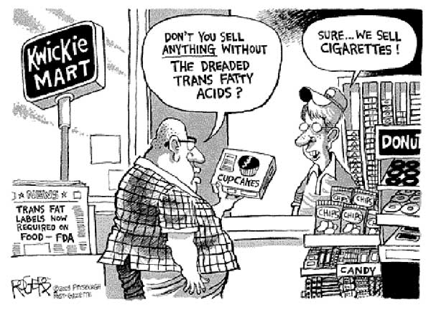
Kwickie Mart Cartoon
Notes:
There IS one other thing you can get in the kwickie mart that does not contain trans fats, and that’s pork cracklings. Be sure to get plain pork cracklings, not the flavored ones, which are full of MSG.

Slide 35
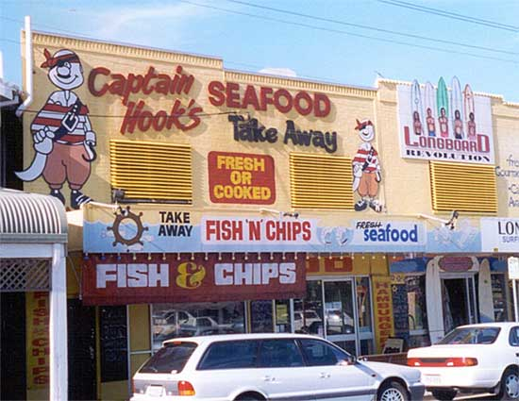
New Zealand Fast Foods
Notes:
This photograph was taken in New Zealand. It shows an independently owned fish’n’chips shop, which I thought might be selling some healthy fast food. There is a great need for healthy fast food in the US—we can’t expect everyone to cook every meal at home.

Slide 36
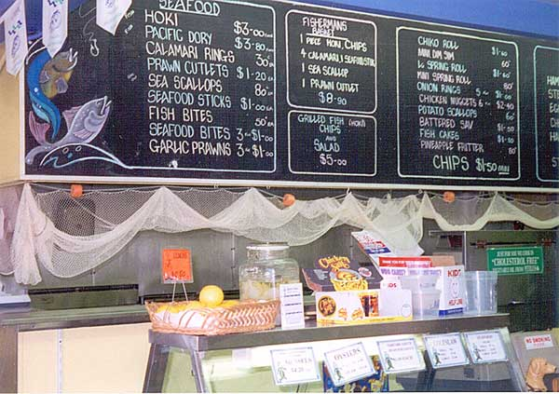
FishNChips 2
Notes:
The shop offers many foods that are healthy, even foods that are sacred foods—fish, scallops, prawns, oysters, etc.
These foods are fried, of course, but some of us can’t eat oysters raw, but enjoy them occasionally fried.

Slide 37
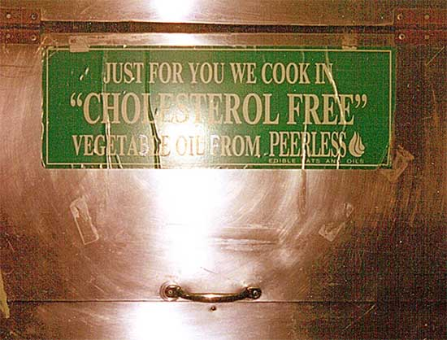
FishNChips 3
Notes:
Then I noticed this sign on the wall: “Just for you we cook in ‘cholesterol free’ vegetable oil from Peerless.”
So I asked if I could talk to the owner and he came out. I asked him how long he had been cooking in Peerless vegetable oil. He said, “About two years.”
I asked him what he had used before. He said, “Something called 90-10.” That was a blend of 90 percent tallow and 10 percent other fat. Tallow is a safe and healthy fat for frying.
I asked him why he switched. He said, “Some of my customers complained that I was using an animal fat that contained cholesterol and saturated fat. I switched because some of my customers were asking for a healthy oil.”
I asked him how he liked the vegetable oil for frying. He lowered his voice: “Actually, I don’t like it very much. The food doesn’t taste as good, it is greasier. . . and it is more expensive!”
Also, the oil he was using was imported. So in New Zealand, where they have an abundance of sheep and cattle, hence an inexpensive source of tallow, they are using imported soy oil for frying, all in the name of bogus health benefits.
I look forward to the day when our fast food shops are locally owned, even owned by farmers cooperatives, and feature locally grown foods. And on the wall there will be a sign that says: “Just for you, we cook in tallow and lard from local grass-fed animals.”

Slide 38
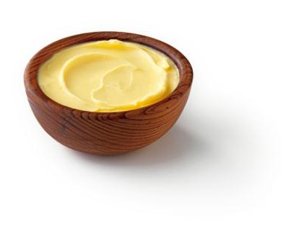
GOOD THINGS IN BUTTER
HIGH LEVELS IN
GRASS-FED BUTTER
Vitamin A
Vitamin D3
Vitamin E
Vitamin K2
Copper
Zinc
Chromium
Selenium
Iodine
Conjugated Linoleic Acid
IN ALL BUTTER
Shorter Chain Fatty Acids
Essential Fatty Acids
IN PERFECT BALANCE
Lecithin
Cholesterol
Glycosphingolipids
Arachidonic Acid
Wulzen Factor
DESTROYED BY PASTEURIZATION
Notes:
So switch to butter and profit from the many nutrients in this natural, healthy fat.
Butter contains fat-soluble vitamins. We have discussed the important benefits of vitamins A, D and K2 (which will only be in the butter if the cows are on green pasture). But vitamin E is also important. Vitamin E protects our cells against free radicals and is essential for normal reproduction.
Butter is a good source of many trace minerals, including copper, zinc, chromium, selenium and iodine.
The combination of vitamin A and iodine makes butter an excellent food for the thyroid gland. In mountainous regions where the soil is deficient in iodine, butter concentrates what little is available (or is provided in salt licks) and helps prevent thyroid problems. Once, after listening to this lecture, a young man told me that his mother grew up in Romania. She was the only one in her village who developed a goiter. She hated butter, never touched it. But everyone else ate plenty of butter.
Butter contains important shorter-chain fatty acids and a nice balance of essential fatty acids. It contains lecithin, which helps the body use cholesterol properly, and the Wulzen factor, which helps prevent arthritis. It contains cholesterol, which is a nutrient, and glycosphingolipids, which aid digestion. Finally, if the cows are on green grass, butter will contain CLA, a strong anti-cancer substance.
All of these factors are rather stable and survive pasteurization except the Wulzen factor, which is destroyed by pasteurization. The best butter, of course, is raw butter from cows on green pasture, but if you only have access to pasteurized butter, be sure to get butter from cows that graze on pasture. Sources are listed in the Shopping Guide, published yearly by the Weston A. Price Foundation.

Slide 39
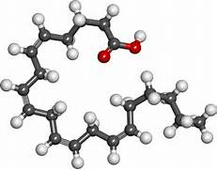
ARACHIDONIC ACID
20 CARBONS
4 DOUBLE BONDS
Elongated omega-6 fatty acid found only in animal fats.
Needed to balance the elongated omega-3 fatty acids in seafood.
Needed for tight skin-to-skin junctions.
Supports healthy skin and healthy digestion
The precursor to our natural cannabinoids.
Notes:
One very important type of fatty acid we get from animal fats is arachidonic acid. It is critically important for a healthy, non-leaky gut.
We also make natural cannabinoids out of arachidonic acid. Has the movement away from animal fats led to increased usage of marijuana, something people seek out so they can just feel normal?

Slide 40
DISEASE TRENDS AND BUTTER CONSUMPTION
POUNDS OF BUTTER per CAPITA per YEAR
% OF CANCER AND HEART DISEASE RELATED DEATHS
Notes:
While butter consumption in the US has plummeted, cancer and heart disease rates have risen dramatically. We do not know all the reasons for these epidemics, but one thing for sure, they are not caused by butter consumption because the trends are going in opposite directions.

Slide 41
THE OILING OF AMERICA!
US DIETARY FAT
ANIMAL AND VEGETABLE SOURCES
GRAMS per CAPITA per DAY
SOURCE: HNIS-USDA
Notes:
This graph illustrates what we call “The Oiling of America,” the changes in the types of fats we are consuming over the course of the last century.
Butter consumption has gone down from 18 grams per person per day to 5; hardly anyone uses lard anymore.
Shortening consumption has increased almost three-fold. And the shortening in 1909 was made from coconut oil and lard, it was a natural product. Today the shortening is made from partially hydrogenated vegetable oil.
Margarine consumption has increased over five-fold.
And the consumption of liquid vegetable oils has increased over 15-fold.
Most people are not aware of these changes, changes which are contributing to widespread disease and infertility. The situation is similar to that in Roman times, when lead from lead pipes contaminated the drinking water and contributed to a decline in fertility in the Roman Empire. Commentators of the period noted the decline in fertility but no one knew that the pipes were the problem. Very few people today realize that the change from animal fats to vegetable oils is the basic cause of our modern medical problems, including infertility.

Slide 42

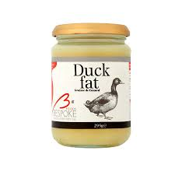
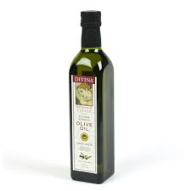
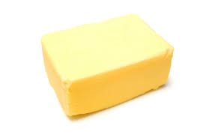
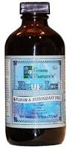
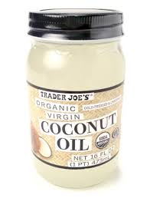
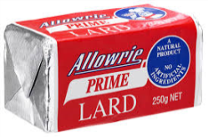
THE SIX BASIC GOOD FATS AND OILS
Pastured Butter, Extra Virgin Olive Oil, Pastured Lard, Coconut Oil, Fermented Cod Liver Oil
Notes:
Here we have the six basic good fats and oils:
Butter for spreading and putting on everything
Lard for cooking
Duck Fat for cooking, and great source of vitamin K2
Olive oil for salad dressing
Cod Liver Oil for vitamins A and D
Coconut oil in food and for cooking

Slide 43
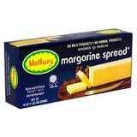
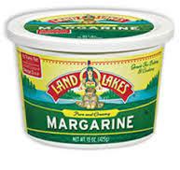
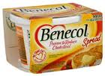
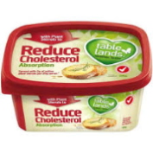

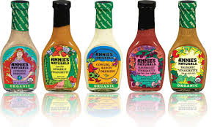




THE BAD FATS!
Notes:
All the bad fats
Margarines and spreads
Commercial salad dressings
Cooking oils
Products containing industrial oils

Slide 44
3. MAKE SURE YOUR DIET CONTAINS SUFFICIENT HIGH-QUALITY ANIMAL PRODUCTS, SOME RAW
HIGH QUALITY =
Whole raw dairy products from pastured cows
Eggs from pastured chickens
Meats from pastured animals
Organ meats from pastured animals
Fish eggs
Fish and shellfish
Cod liver oil
Notes:
The third way to change your diet for the better is to make sure your diet contains sufficient high quality animal products, some of which should be consumed raw.
However, don’t overdo on animal protein. Remember to eat your meat with the fat, eat organ meats whenever you can, eat chicken with the skin, eggs with the yolks and milk with the butterfat. Don’t overdo on the protein and avoid all protein powders. 10-15 percent of total calories as protein is adequate, especially if the protein is of good quality. Eat as much good fat as you want, and moderate amounts of carbohydrate foods.

Slide 45

Fish Egg Photo
Notes:
One very high-quality animal food is fish eggs, which were sacred foods in many cultures. These are salmon eggs, which are available seasonally and much less expensive than caviar. Serve them on buttered toast—delicious.
Pregnant and nursing women should consume fish eggs as often as possible.

Slide 46

THE PASTURED POULTRY MODEL
Notes:
The new method of pastured poultry produces an egg much richer in nutrients such as vitamin A, vitamin D. vitamin K2 and omega-3 fatty acids. Chickens spend the night in moveable chicken coups that are moved to new pasture every day, preferably after cows have grazed so that the chickens can eat the bugs under the cow paddies.
Organic eggs, by the way, are not produced on pasture, but in barns. To obtain pastured eggs, you need to purchase them directly from a farmer. The local chapters of the Weston A. Price Foundation can help you find farmers engaged in pasture-based farming near you.

Slide 47




THE SACRED COW
A Step-Up Transformer of Grass and Sunlight into the
Vital Fat-Soluble Activators A, D and K2
Notes:
Healthy milk comes from contented cows on pasture, eating the foods that cows were designed to eat. The cows have normal-sized udders and are not stressed.

Slide 48


CONFINEMENT CHICKEN OPERATIONS
AS MANY AS 65,000 BIRD UNDER ONE ROOF.
BIRDS KEPT IN CAGES STACKED SEVERAL HIGH.
DEAD BIRDS ARE COLLECTED EVERY DAY.
Notes:
Most commercial chicken is produced in confinement, in buildings that can house up to 65,000 birds under one roof. They are kept in cages stacked several high and de-beaked so that they do not peck on their neighbors. They need constant antibiotics to keep them alive. Feed is designed to induce rapid growth, not quality meat and eggs.

Slide 49


MODERN CONFINEMENT AGRICULTURE
Notes:
More photos of confinement operations.

Slide 50


ORGANIC POULTRY PRODUCTION
Notes:
These photos show the organic poultry model—this is what is know as “free range” or “cage free .” They have “access to the outdoors,” usually a small opening into a fenced yard, which they rarely use because they are afraid to go outside. While this model is certainly better than the conventional model, it is not the pasture-based model.

Slide 51

Real Eggs
EGG YOLKS
8 times more vitamin D,
2 times more vitamin A
in pastured egg compared to supermarket egg
Supermarket Egg
Pastured Egg
Organic Egg
Notes:
The color of the yolk is an indication of the presence of nutrients. In preliminary testing we found 8 times more D and 2 times more A in pastured eggs compared to supermarket eggs.

Slide 52


EGG YOLKS AND VITAMIN D
EGG YOLKS A POTENT SOURCE:
In 1929, researchers tested a variety of foods for vitamin D content and found the second most potent source of vitamin D was egg yolk. Number one was cod liver oil.
BRIGHT SUNLIGHT REQUIRED:
The amount of vitamin D in egg yolks varies. Researchers in Kansas compared vitamin D in egg yolks under various conditions. Only those exposed to bright sunlight, containing UV-B light, or those exposed to a lamp producing UV-B light resulted in eggs with sufficient levels of vitamin D. Egg yolks from chickens under glass or in cages produced rickets in rats.
Notes:
Just as with cows, chickens need to be outdoors in order to put fat-soluble vitamins such as vitamin D into their egg yolks.

Slide 53

Confinement Butter vs. Grass-Fed Butter
CONFINEMENT BUTTER
GRASS-FED BUTTER
10-13 TIMES MORE VITAMIN A AND
3 TIMES MORE VITAMIN D IN GRASS-FED BUTTER
Notes:
The butter on the left was made from supermarket cream—it is virtually white! The butter on the right was made from cream from cows on green pasture. The deep yellow color is indicative of high levels of fat-soluble vitamins. Of course, commercial butter has color added so the consumer does not know that it is actually colorless.
Preliminary testing found 10-13 times more A and 3 times more D in grass-fed butter compared to confinement butter.

Slide 54

CHICKEN LIVERS
CONVENTIONAL
ORGANIC
PASTURE RAISED
Notes:
You can see a big difference the quality of the chicken livers depending on the production method.
And it’s a good bet there are more nutrients in the pasture-raised livers than the organic or conventional.

Slide 55

Modern Farming
Notes:
Industrial agriculture stresses rapid growth, not nutritional quality.

Slide 56


A Campaign for
FULL-FAT
PASTURE-FED
UNPROCESSED
By the Weston A. Price Foundation
A Campaign for Real Milk Is a Project of The Weston A. Price Foundation
westonaprice.org
This document is posted at realmilk.com.
Updated September, 2011

Slide 57

RAW MILK IS UNIQUELY SAFE
Consider the calf, born
in the muck, which then
suckles on its mother’s
manure-covered teat.
How can that calf survive?
Because raw milk contains multiple, redundant systems of bioactive components that can reduce or eliminate populations of pathogenic bacteria.
Notes:
This brings us to the subject of raw milk, which health officials consider an “inherently dangerous” food. The premise that raw milk is dangerous—far more dangerous than other foods—is based on forty-year-old science.
Consider the calf, born in the muck, which then suckles on its mother’s manure-covered teat. How can that calf survive?
Because raw milk contains multiple, redundant systems of bioactive components that can reduce or eliminate populations of pathogenic bacteria

Slide 58
Built-In Protective Systems in Raw Milk LACTOPEROXIDASE
HYDROGEN PEROXIDE: Uses small amounts of H₂O₂ and free radicals to seek out and destroy pathogens
WIDESPREAD: In all mammalian secretions—breast milk, tears, etc.
HIGHER IN ANIMAL MILK: Lactoperoxidase levels 10 times higher in goat milk than in breast milk
ALTERNATIVE TO PASTEURIZATION: Other countries are looking into using lactoperoxidase instead of pasteurization to ensure safety of commercial milk
British Journal of Nutrition (2000), 84, Suppl. 1. S19-S25.
Indian Journal Exp Biology Vol. 36, August 1998, pp 808-810.
1991 J Dairy Sci 74:783-787
Life Sciences, Vol 66, No 23, pp 2433-2439, 2000
Notes:
One of these compounds is lactoperoxidase, which has powerful anti-microbial qualities. The milk of animals is much higher in lacto-peroxidase than human milk, because animals are dirtier.

Slide 59
Built-In Protective Systems in Raw Milk LACTOFERRIN
PLENTIFUL in raw milk; effectiveness reduced by pasteurization¹
STEALS IRON away from pathogens and carries it through the gut wall into the blood stream; stimulates the immune system¹
TB: In a study involving mice bred to be susceptible to tuberculosis, treatment with lactoferrin significantly reduced the burden of tuberculosis organisms.²
CANDIDA: Mice injected with Candida albicans, another iron-loving organism, had increased survival time when treated with lactoferrin.³
WEIGHT LOSS: Believed to cut visceral fat levels up to 40%⁴
BENEFITS: Many other health benefits—is sold as a supplement!
1. British J Nutrition, 2000;84(Suppl. 1):S11-S17.
2. J Experimental Med, 2002 DEC 02;196(11):1507-1513.
3. Infection and Immunity, 2001 JUN;69(6):3883-3890.
4. MSN-Mainichi Daily News, 2007 APR 11.
Notes:
Speaking Points:
Full Citations:
1. Steijns, Jan; Van Hooijdonk, A.C.M., “Occurrence, structure, biochemical properties and technological characteristics of lactoferrin,” British Journal of Nutrition, 2000;84(Supp 1):S11-S17.
2. Schaible, Ulrich E.; Colins, Helen L.; et al, “Correction of the Iron Overload Defect in B-2-Microglobulin Knockout Mice by Lactoferrin Abolishes Their Increased Susceptibility to Tuberculosis,” Journal of Experimental Medicine, 2002 DEC 02, 196(11):1507-1513.
3. Tanida, Toyohiro; Rao, Fu; et al, “Lactoferrin peptide increases the survival of Candida albicans-innoculated mice by upregulating neutrophil and macrophage functions, especially in combination with Amphotericin B and granulocyte-macrophage colony-stimulating factor,” Infection and Immunity, 2001 JUN; 69(6):3883-3890.
4. Connell, Ryan, “Boom or bust: Breast milk ballyhooed to beat the bulge,” MSN-Mainichi Daily News, 2007 APR 11, available from http://mdn.mainichi-msn.co.jp/waiwai/news/20070411p2g00m0dm002000c.html, accessed 2007 MAY 26.

Slide 60
Built-In Protective Systems in Raw Milk: COMPONENTS OF BLOOD
Leukocytes—Eat all foreign bacteria, yeast and molds (phagocytosis). Destroyed at 56C and by pumping milk. Produce H₂O₂ to activate the lacto-peroxidase system. Produce anaerobic CO₂ that blocks all aerobic microbes. Basis of immunity.
B-lymphocytes – Kill foreign bacteria; call in other parts of the immune system^{1,2}
Macrophages – Engulf foreign proteins and bacteria²
Neutrophils – Kill infected cells; mobilize other parts of the immune system¹
T-lymphocytes – Multiply if bad bacteria are present; produce immune-strengthening compounds¹
Immunoglobulins (IgM, IgA, IgG1, IgG2)--Transfer of immunity from cow to calf/person in milk and especially colostrum; provides “passive immunization”²
Antibodies—Bind to foreign microbes and prevent them from migrating outside the gut; initiate immune response.
Scientific American, December 1995.
2. British J of Nutrition, 2000:84(Suppl. 1):S3-S10, S75-S80, S81-S89, S135-136.
Notes:
Speaking Points:
Full Citations:

Slide 61
Built-In Protective Systems in Raw Milk: FATS AND CARBOHYDRATES
Polysaccharides—Encourage the growth of good bacteria in the gut; protect the gut wall
Oligosaccharides – Protect other components from being destroyed by stomach acids and enzymes; bind to bacteria and prevent them from attaching to the gut lining; other functions just being discovered.^{1,2}
Medium-Chain Fatty Acids—Disrupt cell walls of bad bacteria; levels so high in goat milk that the test for the presence of antibiotics had to be changed; may reduce intestinal injury and protect the liver.³
Phospholipids and Spingolipids—bind to intestinal cells, prevent absorption of pathogens and toxins.³ Spingolipids are important components in cell membranes, protect cells against toxins, support digestion and protect against cancer.
1. British J Nutrition, 2000:84(Suppl. 1):S3-S10.
2. Scientific American, December 1995.
3. International Dairy Journal 2006 16:1374-1382 and 1362-1373
4. Spingolipids and Cancer, scitopics.com; Koopman, J S, et al, AJPH, 1984, 74:12:1371-1373
Notes:
Speaking Points:
Full Citations:
1. Newman, Jack, “How Breast Milk Protects Newborns,” Scientific American, December 1995, page 76.
2. Shah, Nagendra P., “Effects of milk-derived bioactives: an overview,” British Journal of Nutrition, 2000;84(Supp 1):S3-S10.
3. Korhonen, Hannu; Marnila, P.; et al, “Milk immunoglobulins and complement factors,” British Journal of Nutrition, 2000;84(Supp 1):S75-S80.
4. Cross, Martin L.; Gill, H.S., “Immunomodulatory properties of milk,” British Journal of Nutrition, 2000;84(Suppl 1):S81-S89.

Slide 62
Built-In Protective Systems in Raw Milk: OTHER BIOACTIVE COMPONENTS
Enzymes, e.g. Complement & Lysozyme—Disrupt bacterial cell walls. Complement destroyed at 56C; Lysozyme at 90C.^{1,2}
Hormones & Growth Factors – Stimulate maturation of gut cells; prevent “leaky” gut.²
Mucins – Adhere to bacteria and viruses, preventing those organisms from attaching to the mucosa and causing disease.^{1,2}
Fibronectin – Increases anti-microbial activity of macrophages and helps to repair damaged tissues.¹
Glycomacropeptide – Inhibits bacterial/viral adhesion, suppresses gastric secretion, and promotes bifido-bacterial growth; supports immune system. ³
1. British J Nutrition, 2000:84(Suppl. 1):S3-S10.
2. Scientific American, December 1995.
3. British J Nutrition, 2000:84(Suppl. 1):S3-S10, S39-S46
Notes:
Speaking Points:
Full Citations:
1. Shah, Nagendra P., “Effects of milk-derived bioactives: an overview,” British Journal of Nutrition, 2000;84(Supp 1):S3-S10.
2. Newman, Jack, “How Breast Milk Protects Newborns,” Scientific American, December 1995, page 76.

Slide 63
Built-In Protective Systems in Raw Milk: OTHER BIOACTIVE COMPONENTS
Beneficial Bacteria – Lactobacilli and bifidus bacteria, crowd out bad bacteria, product lactic acid that kills bad bacteria.
Bifidus Factor – Promotes growth of Lactobacillus bifidus, a helpful bacteria in baby’s gut, which helps crowd out dangerous germs^{1,2}
B₁₂ Binding Protein – Reduces Vitamin B₁₂ in the colon, which harmful bacteria need for growth¹
Lactoglobulins: Carry vitamins A and D and possibly other nutrients.³
1. Scientific American, December 1995.
2., British J Nutrition, 2000:84(Suppl. 1):S3-S10, S39-S46.
3. FEBS Journal 2009 276:2251-2265.
Notes:
Speaking Points:
Full Citations:
Newman, Jack, “How Breast Milk Protects Newborns,” Scientific American, December 1995, page 76.
Shah, Nagendra P., “Effects of milk-derived bioactives: an overview,” British Journal of Nutrition, 2000;84(Supp 1):S3-S10.
Brody, Ernest P., “Biological activities of bovine glycomacropeptide,” British Journal of Nutrition, 2000;84(Suppl 1):S39-S46.

Slide 64
Fivefold Protective System in Raw Milk
Destroys pathogens in the milk.
Stimulates the Immune system.
Builds healthy gut wall.
Prevents absorption of pathogens and toxins in the gut.
Ensures assimilation of all the nutrients.

Slide 65
Destruction of Built-In Safety Systems by Pasteurization
Component | Breast Milk | Raw Milk | Pasteurized Milk | UHT Milk | Infant Formula
B-lymphocytes Macrophages Neutrophils Lymphocytes IgA/IgG Antibodies B₁₂ Binding Protein Bifidus Factor Medium-Chain FAs Fibronectin Gamma-Interferon Lactoferrin Lysozyme Mucin A/Oligosaccharides Hormones/Growth Factors | active active active active active active active active active active active active active active | active active active active active active active active active active active active active active | inactivated inactivated inactivated inactivated inactivated inactivated inactivated reduced inactivated inactivated reduced active reduced reduced | inactivated inactivated inactivated inactivated inactivated inactivated inactivated reduced inactivated inactivated inactivated inactivated reduced reduced | inactivated inactivated inactivated inactivated inactivated inactivated inactivated reduced inactivated inactivated inactivated inactivated inactivated Inactivated
1. Scientific American, December 1995.
2. The Lancet, 17 NOV 1984;2(8412):1111-1113.
1. Scientific American, December 1995.
2. The Lancet, 17 NOV 1984;2(8412):1111-1113.
Notes:
Speaking Points: This is a very important slide. We have listed all the known protective components in milk and show that they are mostly inactivated by pasteurization. Pasteurization destroys milk’s amazing built-in safety system.
Full Citations:
1. Newman, Jack, “How Breast Milk Protects Newborns,” Scientific American, December 1995, page 76.
2. Narayanan, Indira; Murthy, N.S.; et al, “Randomised controlled trial of effect of raw and holder pasteurised human milk and of formula supplements on incidence of neonatal infection,” The Lancet, 17 NOV 1984;2(8412):1111-1113.

Slide 66

FOOD-BORNE ILLNESS 1999-2006
Notes:
All the attention on raw milk when you realize that dairy products—all dairy products—account for a very small proportion of food-borne illnesses cases. And dairy products are consumed at much greater amounts than fish and shellfish. And you can still purchase raw oysters!

Slide 67
FOODBORNE ILLNESS DEATHS since 1999
Cantaloupe: 29 (2011)
Spinach: 5 (2007)
Luncheon Meat: 12 (Canada, 2008); 2 (2011)
Peanuts: 9 (2009)
Eggs: 30 PER YEAR
Oysters: 15 PER YEAR
Pasteurized Cheese: 7 (Europe, 2009)
Pasteurized Milk: 3 (2007)
Pasteurized Mother’s Milk: 4 (2003)
Raw Milk: NONE

Slide 68
LISTERIA
Around 300 deaths per year from listeria; thousands of illnesses.
Most common sources
Luncheon Meats
Soft un-aged cheeses
NO cases of listeria from raw milk

Slide 69
Some Outbreaks Due to Pasteurized Milk
1976—1 outbreak Y. enterocolitica in 36 children, 16 of whom had appendectomies, due to pasteurized chocolate milk¹
1982—Over 17,000 cases Y. enterocolitica in several states from milk produced in Memphis, TN²
1983—1 outbreak, 49 cases, 14 deaths from L. monocytogenes in MA²
1984-85—3 outbreaks of antimicrobial-resistant S. typhimurium, at plant in Melrose Park IL.The third wave had 16,284 confirmed cases; surveys indicated as many as 197,581 persons may have been affected²
1985—1,500+ cases, Salmonella culture confirmed, in Northern IL²
1993-94—1 outbreak, 2014 cases/142 confirmed S. enteritidis due to pasteurized
in MN, SD, WI⁶
1995—Outbreak of Yersinia enterocolitica in 10 children, 3 hospitalized due to post-pasteurization contamination⁷
2000—1 outbreak, 98 cases/38 confirmed S. typhimurim in PA and NJ⁷
2005—1 outbreak, 200 cases C. jejuni in CO prison⁹
2006—1 outbreak, 1592 cases/52 confirmed C. jejuni infections in CA¹⁰
2007—1 outbreak, 3 deaths from pasteurized milk in Massachusetts
2009—1 outbreak, 7 deaths from pasteurized cheese in Europe
2012 –1 outbreak, 4 deaths from pasteurzed cheese in the US
Notes:
Full Citations:
1. (1976) Black, R.E.; Jackson, R.J.; et al; “Epidemic Yersinia enterocolitica infection due to contaminated chocolate milk,” New England Journal of Medicine, January 12, 1978; 298(2):76-79. Milk was purchased in school cafeterias; investigation suggested that the bacterium was introduced at the dairy during the mixing by hand of chocolate syrup with previously pasteurized milk.
2. (1982) Segal, Marian; “Invisible villains; tiny microbes are biggest food hazard,” FDA Consumer, JUL-AUG 1988.
3. (1983) Fleming, D.W.; Cochi, S.L.; et al; “Pasteurized milk as a vehicle of infection in an outbreak of listeriosis,” New England Journal of Medicine, 1985 FEB 14; 312(7):404-407.
4. (1984-1985) Ryan, C. A.; Nickels, M. K.; et al; “Massive outbreak of antimicrobial-resistant salmonellosis traced to pasteurized milk,” Journal of the American Medical Association, 1987;258:3269-74. Two surveys to determine the number of persons who were actually affected yielded estimates of 168,791 and 197,581 persons, making this the largest outbreak of salmonellosis ever identified in the United States.
Details of three outbreaks:
1984-AUG, 1 outbreak of S. typhimurium, ~200 cases
1984-NOV, 1 outbreak S. typhimurium,
1985-MAR, 1 outbreak S. typhimurium, 16,284 confirmed cases
5. (1985) Centers for Disease Control and Prevention, “Milk-Borne Salmonellosis—Illinois,” Morbidity & Mortality Weekly Report, 1985 APR 12; 34(14):200. http://www.cdc.gov/MMWR/preview/mmwrhtml/00000520.htm
6. (1993-1994) Centers for Disease Control and Prevention, “Outbreak of Salmonella enteritidis Associated with Nationally Distributed Ice Cream Products--Minnesota, South Dakota, and Wisconsin, 1994,” Morbidity & Mortality Weekly Report, 1994 OCT 14; 43(40). http://vm.cfsan.fda.gov/~mow/salice.html; accessed 28 May 2007
7. (1995) New Zealand PDF: http://www.nzfsa.govt.nz/science/data-sheets/yersinia-enterocolitica.pdf which mentions “10 cases, 3 hospitalised, 1 appendectomy. Control measure failure: post pasteurisation contamination.” US reference is Robbins-Browne, R. (1997) Yersinia enterocolitica. In Food Microbiology: fundamentals and frontiers, (Eds) Doyle, M.P., Beuchat, L.R. and Montville, T.D. pp192-215. ASM Press, Washington, D.C., USA.
8. (2000) Olsen, Sonja J.; Ying, Michelle; et al; “Multidrug-resistant Salmonella Typhimurium infection from milk contaminated after pasteurization,” Emerging Infectious Diseases [serial on the Internet], 2004 MAY; available at http://www.cdc.gov/ncidod/EID/vol10no5/03-0484.htm, accessed 28-May-2007.
9. CDC 2005 Summary Statistics, http://www.cdc.gov/foodborneoutbreaks/us_outb/fbo2005/2005_Linelist.pdf. Also mentioned briefly in State of Colorado Laboratory Services Division 2005-2006 Annual Report, page 17, http://www.cdc.gov/foodborneoutbreaks/us_outb/fbo2005/2005_Linelist.pdf (“The Environmental Microbiology Laboratory recovered Campylobacter from milk samples in the Colorado prison system.”)
10. (2006) Yuan, Jean W.; Jay, M.T.; et al, “Campylobacteriosis Outbreak Associated with Pasteurized Milk — California, May 2006,” Epidemic Intelligence Service Conference 2007 (CDC), 2007 APR 16; page 62. Available at http://www.cdc.gov/eis/conference/archives/EIS_program%20indd.pdf, accessed 28-May-2007. This was a paper presented at a conference.

Slide 70
Breast Milk Contains Pathogens
MISCONCEPTION: Until recently, the medical profession claimed that breast milk was sterile.
PATHOGENS: We now know that breast milk contains pathogens, often at very high levels.
IMMUNITY FOR LIFE: The bioactive components in milk program the baby to have immunity for life to any pathogens he comes in contact with.
PASTEURIZE BREAST MILK? Should mothers be required to pasteurize their own milk before giving it to their babies?
DISCRIMINATION: Yet laws prevent mothers from obtaining raw milk to feed their babies should their own supply be inadequate.
J Appl Microbiol. 2003;95(3):471-8.
2. Neonatal Netw. 2000 Oct;19(7)21-5.
3.-11. various medical journals…
Notes:
Until recently, the medical profession insisted that mother’s milk was sterile. Now we know that mother’s milk contains many pathogens—and it is supposed to. By consuming the milk along with the pathogens, the infant develops immunity to these pathogens.
In one study, researchers analyzed human milk in China for pathogens—and were shocked to find out just how high the levels were. Then they learned that it is a custom in China for mothers not to bathe for at least a month after giving birth. Their skin is loaded with pathogens, which get into the milk. There is great wisdom here, because by exposure to pathogens while consuming raw mothers milk, the babies develop immunity for life to all they are exposed to.
Should mothers be required to pasteurize their own milk before giving it to their babies? Of course not! Yet laws prevent mothers from obtaining raw milk to feed their babies should their own supply be inadequate.

Slide 71


The Campaign Against Raw Milk Coronet Magazine, May 1945
Article in Coronet Magazine, May, 1945
Seemingly factual article about a town called Crossroads, USA, where many died from undulant fever, contracted from raw milk
One small problem: the whole story was made up, there was no Crossroads, USA, and no outbreak of undulant fever!

Slide 72

The Campaign Against Raw Milk
August, 1946, Reader’s Digest repeated false story about Crossroads, USA
Lies about raw milk continue to this day!

Slide 73
Bias in Reporting Safety of Raw Milk 1983 Georgia Outbreak
OUTBREAK of campylobacter infection in Atlanta.
EXTENSIVE TESTING failed to find campylobacter or any other pathogens in any milk products from the dairy. All safety measures had been followed faithfully.
AUTHORS’ CONCLUSION: “The only means available to ensure the public’s health would be proper pasteurization before consumption.”
DAIRY CLOSING: Led to closing of Mathias raw milk dairy.
American Journal of Epidemiology, 1983 Vol 114, No 4
Notes:
Bias is obvious in many studies the government uses to argue against raw milk. This study led to laws banning the sale of raw milk in the state of Georgia.

Slide 74
Bias in Reporting Safety of Raw Milk 2001 Wisconsin Outbreak
OUTBREAK: November 2001 outbreak of campylobacter in Wisconsin blamed on raw milk from a cow-share program in Sawyer County. The farm has an outstanding safety record.
OFFICIAL REPORT: 70-75 persons ill. (CDC Website)
INDEPENDENT REPORT: Over 800 ill during 12 weeks after
HAMBURGER LIKELY CAUSE: Only 24 of 385 cow share owners became ill. Most had consumed hamburger at a local restaurant. No illness in remaining 361 cow-share owners.
BIAS: Local hospitals tested only those who said they had consumed raw milk; others sent home without investigation.
LAB TESTS CLEAN: Independent lab tests found no campylobacter in the milk.
Notes:
This outbreak in Wisconsin was all over the news. The government excluded the hundreds of sick people who did not drink raw milk from their statistics.

Slide 75
FDA Powerpoint Presentation Warning Against Raw Milk, Citing 15 Studies
No Valid Positive Milk Sample | 12/15 | 80%
No Valid Statistical Association with Raw Milk | 10/15 | 67%
Findings Misrepresented by FDA | 7/15 | 47%
Alternatives Discovered, Not Pursued | 5/15 | 33%
No Evidence Anyone Consumed Raw Milk Products | 2/15 | 13%
Outbreak Did Not Even Exist | 1/15 | 13%
Did Not Show that Pasteurization Would Have Prevented Outbreak | 15/15 | 100%

Slide 76

Decline of Infectious Disease Not Related to Mandatory Pasteurization
1948: First State Mandatory Pasteurization Laws

Slide 77
Raw Milk Production Today
Compared to 30-50 years ago, dairy farmers today can take advantages of many advancements that contribute to a safe product:
Managed rotational grazing ensures healthy cows
Herd testing for disease
Refrigerated bulk tanks
Refrigerated transportation
Easier milk testing techniques
Notes:
We have the knowledge and technology to supply clean, safe raw milk to everyone in the country.

Slide 78

Milk Safety in California
Since 1999:
MILLIONS OF SERVINGS of Organic Pastures raw milk, with a superlative safety record.
MANY RECALLS of
pasteurized milk
products during
the same period.
Notes:
Speaking Points:
Full Citations:

Slide 79
Solution to the “Milk Problem”
During the 1800s, there was a 50% death rate among urban children drinking “Swill Milk,” that is, milk produced in inner city confinement dairies, from cows fed brewery swill and raised in unimaginable filth.
The “Milk Problem” was solved by
Outlawing inner city swill dairies,
The Certified Milk Movement,
which ensured clean raw milk, and
Increased consumer access to refrigeration,
NOT by Milk Pasteurization Laws.
Notes:
Advocates cite pasteurization as the measure that solved the “Milk Problem” but the real solution came with the outlawing of filthy inner city dairies.

Slide 80
Summary of Raw Milk Safety
SAFEST FOOD: Raw Milk is safer than any other food.
BUILT-IN SAFETY MECHANISMS: Raw milk is the ONLY food that has built in safety mechanisms.
40-YEAR-OLD SCIENCE: Claims that raw milk is unsafe are based on 40-year-old science.
COURT OF LAW: Claims that raw milk is unsafe would not hold up in a court of law.
Notes:
Raw Milk is the safest food in the food supply!

Slide 81
Pasteurized Milk = Increasing Health Problems in Children
Allergies
Asthma
Frequent Ear Infections
Gastro-Intestinal Problems
Diabetes
Auto-Immune Disease
Attention Deficit Disorder
Notes:
Pasteurized milk is causing an increasing number of health problems in children.

Slide 82
Heat Resistant Pathogens in Pasteurized Milk
JOHNE’S BACTERIA (paratuberculosis bacteria) suspected of causing Crohn’s disease, now routinely
found in pasteurized milk.
B. CEREUS SPORES survive pasteurization.
BOTULISM SPORES survive pasteurization.
PROTOZOAN PARASITES survive pasteurization.
Elliott Ryser. Public Health Concerns. In: Marth E, Stelle J, eds. Applied Dairy Microbiology, New York, Marcel Dekker, 2001.
Notes:
The industry has always claimed that pasteurization gets rid of all pathogens, but this is not the case.

Slide 83

Proteins in Milk
MILK PROTEINS: Three dimensional, like tinker toys.
CARRIERS: Carry vitamins and minerals through the gut into the blood stream; enhance the immune system; protect against disease.
IMMUNE DEFENSE: Pasteurization and ultra-pasteurization flatten the three-dimensional proteins; the body thinks they are foreign proteins and mounts an immune defense.
DISEASES: Immune attacks lead to juvenile diabetes, asthma, allergies and other disorders later in life.
ALLERGIES: More and more people unable to tolerate pasteurized milk; one of the top eight allergies; some have violent reactions to it.
DECLINE: Consumption of fluid milk declining at 1 percent per year.
LACTOFERRIN
Notes:
Pasteurization flattens and destroys the protein components in milk—and most of the protective components are protein compounds. As a result, the body mounts an immune response to pasteurized milk.
This is why the consumption of fluid pasteurized milk is declining at the rate of 1 percent per year, year after year.

Slide 84
Raw Milk Digestibility
RAW MILK DIGESTS ITSELF!
Enzymes in raw milk are activated in the digestive tract
Enzymes and carrier proteins in raw milk ensure all nutrients are absorbed
Friendly bacteria in milk aid in digestion
No energy required to digest raw milk; net energy gain
PASTEURIZED MILK IS VERY DIFFICULT TO DIGEST
The body must supply the enzymes needed to digest the milk
Proteins warped and distorted by pasteurization put additional strain on digestion
Much energy required to digest pasteurized milk; net energy loss

Slide 85

Studies on Raw vs. Pasteurized Milk at Randleigh Farm, 1935-1940
Above: Rat fed only raw milk. Good development, healthy fur.
Below: Rats fed only pasteurized milk. Poor development. Hairless areas (acrodynia) due to vitamin B-6 deficiency.
Notes:
In studies carried out at Randleigh Farm in the late 1930s, rats fed raw milk thrived, while rats fed pasteurized milk did poorly.

Slide 86

Bone Development
Six-Month Study
PASTEURIZED Milk-Fed Rat, weighed 146 grams
Bones shorter and less dense
RAW Milk-Fed Rat, weighed 206 grams
Bones longer and more dense
One-to-One Exposure of Femur, Tibia and Fibia
Notes:
The raw-milk-fed rats had longer and denser bones. Bones are build during the growth period, which is one reason it is so important for growing children to get raw milk.

Slide 87

Guinea Pig Studies of Wulzen and Bahrs Department of Zoology, Oregon State College, 1941
Whole Raw Milk | Excellent growth; no abnormalities
Whole Pasteurized Milk | Poor growth; muscle stiffness; emaciation and weakness; death within one year. Autopsy revealed atrophied muscles streaked with calcification; tricalcium deposits under skin, in joints, heart and other organs.
American Journal of Physiology 1941, 133, 500
Notes:
In this study, the animals fed pasteurized milk ended up with calcium in all the wrong places.
Remember that atherosclerosis is a condition of calcium deposits in the arteries. This study raises the possibility that pasteurization of our milk is a contributing factor to the steep rise in heart disease starting in the 1950s.

Slide 88

Rat Studies of Scott & Erf Ohio State University, 1931
Whole Raw Milk | Good growth; sleek coat; clear eyes; excellent dispositions; enjoyed being petted.
Whole Pasteurized Milk | Rough coat; slow growth; eyes lacked luster; anemia; loss of vitality and weight; very irritable, often showing a tendency to bite when handled.
Jersey Bulletin 1931 50:210-211;224-226, 237
Notes:
The interesting thing about this study is the difference in behavior between the rats fed raw and pasteurized milk. Those fed pasteurized milk were very irritable and had a tendency to bite when handled.
We have had many parents report much calmer behavior in their children after changing from pasteurized to raw milk. These kinds of changes are what make our mothers so passionate about raw milk. How can our public officials say no to the “passionate moms” who have seen such a better quality of life for their children and themselves just by switching to raw milk?

Slide 89
The Milk Cure
ANCIENT: Since ancient times, an exclusive raw milk diet has been used to cure many diseases.
MAYO CLINIC: In the early 1900s, the “Milk Cure” was used at the Mayo Clinic to successfully treat cancer, weight loss, kidney disease, allergies, skin problems, urinary tract problems, prostate problems, chronic fatigue and many other chronic conditions.
ONLY WITH RAW MILK: The Milk Cure only works with raw milk; pasteurized milk does not have these curative powers.
Crewe, JR. Raw Milk Cures Many Diseases, www.realmilk.com
Notes:
The Milk Cure only works with raw milk. If you tried a diet of exclusively pasteurized milk, it would make you very sick.

Slide 90
Asthma & Raw Milk – 2007
RAW MILK STRONGEST FACTOR: In a study of 14,893 children aged 5-13, consumption of raw milk was the strongest factor in reducing the risk of asthma and allergy, whether the children lived on a farm or not.
FIRST YEAR OF LIFE: The benefits were greatest when consumption of farm milk began during the first year of life.
NINE DEATHS per day from asthma in the U.S.
Clinical & Experimental Allergy. 2007 May; 35(5) 627-630.
Notes:
Speaking Points:
Full Citations: Clinical & Experimental Allergy. 2007 May; 35(5) 627-630.

Slide 91
Lactose Intolerance
29 MILLION: Results from a survey by Opinion Research Corporation (commissioned by the Weston A. Price Foundation) indicate that about 29 million Americans are lactose intolerant.
RAW MILK OK FOR 82 PERCENT: Results from a private survey carried out in Michigan indicate that 82 percent of those diagnosed as lactose intolerant can drink raw milk without problem.
24 MILLION COULD BENEFIT: Thus, 24 million Americans diagnosed as lactose intolerant could benefit from raw milk.

Slide 92
RAW MILK & GLUTATHIONE
Glutathione: Key compound for detoxification
High levels in whey protein
Research in 1991 discovered that whey proteins only boost glutathione status in their raw, undenatured state.
Explains the success of the Milk Cure
Source: http://www.westonaprice.org/blogs/cmasterjohn/2010/09/11/the-biochemical-magic-of-raw-milk-and-other-raw-foods-glutathione

Slide 93


RAW MILK FOR CHILDREN
Calcium for optimal growth, strong bones, strong teeth.
Protection against asthma, allergies, eczema
Builds immune system.
Glutathione for protection against toxins.
Builds healthy gut wall.

Slide 94


Microscopic Structure of Raw Milk
Pasteurized milk magnified 175 times. Complex colloidal structure is lost. Pasteurized milk is “lifeless.”
Raw milk magnified 175 times. Complex colloidal structure similar to that of all life forms. Raw milk is a “living” food.
Photographs by Dr. Beverly Rubik

Slide 95

Microscopic Structure of Raw Milk
Amoeba—cellular structure similar to that of raw milk.
Raw milk magnified 175 times. Complex colloidal structure similar to that of all life forms. Raw milk is a “living” food.
Photographs by Dr. Beverly Rubik

Slide 96



Similarity of Life Forms

Slide 97


Microscopic Structure of Raw Milk
Structure of blood under darkfield microscope.
Raw milk magnified 4200 times. Structure is similar to that of blood.
Photographs by Dr. Beverly Rubik

Slide 98




Confinement Dairy System
Cows never leave stalls. Life span averages 42 months.
Notes:
Here we see a typical confinement operation on the east coast. (In the west, and mid-west, they are much larger, sometimes housing up to 2500 cows under one roof.) The cows are inside eating feed completely inappropriate for cows while beautiful green grass grows outside. The average lifespan of cows in confinement is 42 months. When the cows can no longer produce milk or become lame, they are sent to the butcher. Most of the beef in fast food hamburgers in the US comes from dairy cull cows.

Slide 99
The Modern Cow
Three milkings per day
Often milked for 600 days without a break, or until death.

Slide 100



Modern Milk From Farm to Factory
Notes:
Modern milk is shipped in tanker trucks and processed in large factories where miles of pipes pass the milk through the various high-temperature processes. These pipes must be cleaned out by various solvents and industrial cleaners—and residues invariably end up in the milk.

Slide 101
Feed Given to Confined Cows
Feed | Result in Milk
Soy | Allergenic soy protein and estrogenic isoflavones
GMO Grains | Aflatoxins (liver poisons)
Bakery Waste | Trans fatty acids
Citrus Peel Cake | Cholinesterase inhibitors (pesticides that act as nerve poisons)
Hormones and Antibiotics | Hormones and Antibiotics
Swill from Ethanol Production! | Chemicals used in ethanol production
Notes:
Milk is a very sensitive substance and its quality depends on the feed of the mothers. Many of the problems people have with commercial milk may be due to allergenic proteins and toxic substances from the feed that end up in the milk.

Slide 102


The Wasteland
Compulsory pasteurization laws are largely responsible for the decline of American small towns and rural life.
Pasteurization laws transform what should be a local value-added product into a commodity product.
Notes:
I have traveled all over the country and seen many burnt-out small towns and fallin- down barns. In Tennessee, for example, there used to be 15,000 dairy farms. Today there are less than 1000 and the landscape is littered with abandoned farms. More than any other factor, compulsory pasteurization law are responsible for the decline of American small towns and rural life.

Slide 103



Raw Milk in Europe
Legal in England, Wales and Ireland– the royal family drinks raw milk!
Widely available in continental Europe through vending machines. . . even in schools!

Slide 104
Arthur Schopenhauer
ALL TRUTH PASSES THROUGH THREE STAGES:
First, it is ridiculed.
Second, it is violently opposed.
Third, it is accepted as self-evident.
Notes:
Until recently, authorities merely ridiculed proponents of raw milk. Now that we have amassed so much evidence on the safety and health benefits of raw milk, we are entering into the second stage—violent opposition. But I predict that within 10 years, both health officials and consumers will accept it as self evident that raw milk is a superior food.

Slide 105


Slide 106

Farm-To-Consumer Legal Defense Fund (FTCLDF)
Legal Defense for Small Farmers
Raw Milk Protection
Right to On-Farm Processing and Direct Sales
Legal Opposition to Animal Identification
Help with farm-share and cow-share programs
Website: farmtoconsumer.org
Phone: (703) 208-FARM
Notes:
Speaking Points:
Full Citations:

Slide 107

www.realmilk.com
A Project of the Weston A. Price Foundation.
Many articles on raw milk and raw cheese.
Sources for raw milk.

Slide 108

RESOURCES
The Untold Story of Milk REVISED AND UPDATED
by Ron Schmid
New Trends Publishing
newtrendspublishing.com
(877) 707-1776
Notes:
Speaking Points:
Full Citations:

Slide 109

4. ELIMINATE REFINED SWEETENERS
SUGAR
DEXTROSE
FRUCTOSE
GLUCOSE
HIGH FRUCTOSE CORN SYRUP
FRUIT JUICES
Notes:
The first three ways to change your diet for the better are relatively easy to accomplish. This is the hard one. Sugar can be addictive and it is very hard to eliminate it entirely from your diet.
Try to eliminate sugar but don’t be too hard on yourself if you fall off the wagon sometimes. And remember, that when sugar is consumed with fats (good fats, like butter and coconut oil), the rush of glucose into the bloodstream is slowed down and the harmful effects are somewhat mitigated.
Refined sweeteners include sugar, dextrose, fructose and glucose—anything ending in “ose.” High fructose corn syrup is a refined sweetener, as are agave syrup and commercial fruit juices. When you drink a glass of fruit juice, you are getting the amount of sugar contained in many pieces of fruit—whereas if you are eating a piece of fruit, you get the sugar of just one, plus all of the fiber and vitamins.
And there is another problem with fruit juices, particularly commercial orange juice. Citrus crops are sprayed with some of the most noxious pesticides available. They are called cholinesterase inhibitors, which are neurotoxins that inhibit brain function. The modern method of making juice squeezes the whole fruit, including the skin, so that these pesticides end up in the juice. Researchers in Hawaii have been looking at the relationship of diet with early dementia and Alzheimer's disease. The found that the major factor associated with mental decline was excessive consumption of fruit and fruit juice. In their report, they suggested that it was not the fruit itself that caused these problems, but the pesticides sprayed on the fruit.

Slide 110
Sucrose, Glucose and Fructose
SUCROSE
GLUCOSE
FRUCTOSE
IN ANIMAL STUDIES, FRUCTOSE WAS FOUND
TO BE HARMFUL WHILE GLUCOSE WAS NOT.
Notes:
Sucrose (in sugar) is a di-saccharide that is broken down into glucose and fructose during digestion.
Animal studies conducted at USDA found that high levels of sugar in the diets of rats are very harmful.
These studies were repeated looking at high levels of glucose and fructose separately. Glucose caused no harm, but the fructose portion of sugar was very harmful. Either the females did not reproduce or the young did not reach adulthood. Fructose seems to interfere with the production of collagen in growing animals. This is one reason high fructose corn syrup and fruit juices are so harmful for growing children.
.

Slide 111
FRUCTOSE AND HEALTH
LIVERS of rats on high-fructose diet resembled livers of alcoholics.
ANEMIA
HEART HYPERTROPHY - enlarged and exploded
COPPER DEFICIENCY in combination with fructose interferes with collagen production, hence rat bodies fell apart. Copper deficiency widespread in the United States.
DELAYED testicular development in male rats.
FEMALE RATS were unable to produce live young.
MALE RATS did not reach adulthood.
Notes:
Glucose is metabolized by every cell in the body, but fructose is metabolized only in the liver. The livers of the animals on the high-fructose diet looked like cirrhotic livers, like the livers of alcoholics.
Another interesting finding was delayed testicular development in male rats. The hearts became very enlarged and finally exploded.
Fruit is fine in moderation, but avoid fruit juices and any product containing high fructose corn syrup. It is VERY important to keep fruit juices away from growing children.

Slide 112
US CONSUMPTION OF REFINED SUGARS
POUNDS per CAPITA per YEAR
SOURCE: USDA
Notes:
During the past 20 years, consumption of refined sugar has actually declined, but the consumption of high fructose corn syrup has more than doubled, resulting in a higher per capita consumption of total sweeteners.
High fructose corn syrup is used in soft drinks, many products sold in health food stores and many products aimed at children.
High fructose corn syrup and agave syrup are made by the enzymatic conversion of glucose to fructose. The fructose is not quite the same as natural fructose, so the body can’t use it for energy in the Kreb’s cycle. The body puts it into tryglycerides or stores it as fat.

Slide 113

DISEASES ASSOCIATED WITH CONSUMPTION OF REFINED SWEETENERS
DIABETES
HYPOGLYCEMIA
CHRONIC ELEVATED INSULIN
CORONARY HEART DISEASE
CANCER
INFECTIOUS DISEASES
HYPERACIDITY OF THE STOMACH
LIVER DISEASE
KIDNEY DISEASE
INFERTILITY
ASTHMA
ACNE
HEADACHES
THYROID MALFUNCTION
ADRENAL MALFUNCTION
OBESITY
INCREASED DESIRE FOR ALCOHOL
INCREASED DESIRE FOR COFFEE AND TOBACCO
CANDIDA ALBICANS INFECTION
BONE LOSS
DENTAL DECAY
HYPERACTIVITY
VIOLENT TENDENCIES
DEPRESSION
Notes:
There are many diseases associated with excess consumption of refined sweeteners, starting with the diseases of glucose metabolism—diabetes and hypoglycemia. Cancer, infectious disease, digestive disorders, endocrine problems, obesity, even behavioral problems such as hyperactivity, violent tendencies and depression.
Sugar creates increased desire for alcohol, coffee and tobacco. . . Sugar is the first addiction and then others follow.
This list is similar to the list of diseases caused or worsened by industrial fats and oils. When you put the two ingredients together, as we do in so many processed foods, you have a health crisis.

Slide 114

NATURAL SWEETENERS USE IN MODERATION
RAPADURA (DEHYDRATED SUGAR CANE JUICE),
MAPLE SYRUP AND MAPLE SUGAR,
MOLASSES, STEVIA POWDER AND RAW HONEY
Notes:
But we don’t want to tell you never to eat sweet foods. We have a sweet taste in our mouths and it needs to be satisfied.
Natural sweeteners are rich in minerals and other nutritional factors. They can be consumed in moderation as part of homemade desserts containing other whole foods such as butter, eggs, cream, whole grains, fruit and nuts.
Fats slow down the rush of sugar to the blood so always eat sweet things with good fats.

Slide 115

AVOID THE BLOOD SUGAR ROLLER COASTER
Always eat sweet things with good fats!
Notes:
Eating fats with sweet things prevents the blood sugar roller coaster, because fats slow down the release of sugar into the bloodstream.

Slide 116

POSSIBLE CAUSES OF SUGAR CRAVINGS
WRONG FATS IN THE DIET
IMPROPER PREPARATION OF GRAINS
TOO FEW OR TOO MANY ANIMAL FOODS
MINERAL DEFICIENCIES
NEUROTOXIC ADDITIVES
SUCH AS MSG AND ASPARTAME
Notes:
Here are several theories on the causes of sugar cravings—presented to you as just theories, with little research to provide any definitive proof.
What we do find is that when people adopt a whole foods diet that includes plenty of good fats, with emphasis on food quality and proper preparation, sugar cravings often disappear.

Slide 117




Supermarket Sweets
Notes:
These are examples of the wrong kind of sweet foods. They are loaded with sugar, industrial fats and oils, and other nasty stuff. Some manufacturers add “appetite stiumlants” to these foods so you “can’t eat just one.” The industry has perfected an addiction technology!
As for ice cream, all commercial ice cream contains propylene glycol (so-called “food grade” antifreeze) so it will be soft when it comes out of the freezer. Antifreeze is a sweet-tasting poison—often used to murder people—that causes kidney failure. Is the huge increase in kidney disease in this country linked to our national addiction to commercial ice cream?

Slide 118


HOMEMADE ICE CREAM
CREAM
MAPLE SYRUP
EGG YOLKS
VANILLA
Notes:
But we would never tell you not to eat ice cream, a dessert that is delicious and can be made with nutritious ingredients. And using an modern ice cream freezer, it is easy to make.
The ingredients for basic vanilla ice cream are good quality cream, maple syrup, several egg yolks and vanilla. Simply mix them together. You can also add a puree of fruit, chopped nuts, etc.
It takes no more than a few minutes to prepare the ice cream mix in your ice cream maker.

Slide 119




Homemade Ice Cream Steps
Notes:
Use the type of ice cream maker that has a double-walled canister that is kept chilled in the freezer. Pour in the mix and in 20 minutes you have ice cream.
Store ice cream in shallow containers so that it will soften after only about 5-10 minutes out of the freezer. Another trick is to add about 2 tablespoons of vodka to the ice cream mix as this will lower the freezing temperature and keep the ice cream slightly softer.

Slide 120
CARBOHYDRATES OR FATS? WHICH PROVIDE THE MOST ENERGY?
One molecule GLUCOSE requires
One molecule FAT requires
15 enzymes
Numerous vitamins and minerals, especially chromium and magnesium
5 enzymes
Vitamins and
minerals
38 UNITS ATP
146 UNITS ATP
ATP = Energy carrier
Notes:
The comparative metabolic pathways of carbohydrates and fats are instructive. One molecule of glucose requires about fifteen enzymes and numerous vitamins and minerals, especially chromium and magnesium, to produce thirty-eight units of ATP (the energy carrier in our cells.)
One molecule of fat requires far fewer enzymes, vitamins and minerals to produce 146 units of ATP.
This chart also illustrates the importance of eating whole foods, particularly natural sweeteners. If we eat refined sugar, we quickly use up nutrients that should have been part of the food. Similarly, if we consume processed oils, we also use up nutrients that should have been part of the oils or fats.

Slide 121

5. ELIMINATE TOXIC METALS AND ADDITIVES AS MUCH AS POSSIBLE
Notes:
The fifth way to change your diet for the better is to eliminate toxic metals and additives as much as possible.
Remember that phrase “as much as possible.” It is impossible to completely eliminate exposure to toxins—our primitive ancestors were exposed to many toxins, specifically in smoke. The healthy body has numerous enzyme systems designed to neutralize toxins.
If we minimize exposure and eat a healthy diet, the body can deal with a certain amount of exposure to environmental poisons.

Slide 122
SOURCES OF TOXIC METALS
ALUMINUM Cookware
Antacids
Commercial salt
Baking powder
Deodorants
MERCURY Amalgam fillings
Large fish, such as swordfish and tuna
LEAD Water from lead pipes
Some cookware glazes and enamels
Dark hair dyes
IRON All commercial white flour products
CADMIUM Commercially raised fruits and vegetables
Notes:
The main toxic metals and their sources are listed here. The main sources of aluminum are cookware, antacids, commercial salt, baking powder and deodorants. Above all, avoid aluminum cookware.
A recent concern has been mercury concentrations in swordfish and tuna, so it is best not to eat these large fish too often. But seafood in moderation is fine, especially if you are consuming lacto-fermented foods to feed your beneficial gut flora. A much more serious source is the mercury in amalgam fillings, constantly out-gassing in the mouth.
Lead is not as much of a problems as it used to be. A surprising source is dark hair dyes.
We need iron in our food to prevent anemia, but the inorganic iron in commercial white flour products is not properly assimilated and can lead to iron overload.
Finally cadmium is an ingredient in many pesticides, so avoid commercially raised fruits and vegetables. . . without being too obsessive about it.

Slide 123

EFFECTS OF FLUORIDE
MAIN EFFECTS
Depresses thyroid function
Enzyme inhibitor
LEADING TO
Premature aging
Arthritis
Osteoporosis
Irregular bone growth
Degeneration of bone and cartilage
Mottling of the teeth – fluorosis
Acne and other skin problems
Damage to the immune system
Hardening of the arteries
Genetic damage
Cancer
Violent behavior
Notes:
Fluoride, which is routinely added to drinking water, should be avoided as much as possible. First and foremost, fluoride is a thyroid inhibitor. Poor thyroid function leads to many of the other problems in this list.
If your water is fluoridated, you will want to install a water filter that takes out the fluoride, preferably one that works by reverse osmosis. Use this filtered water for drinking and cooking.
Officials claim that fluoride is beneficial, that it prevents tooth decay. Recent studies have shown that there is just as much tooth decay in fluoridated areas as in non-fluoridated areas.
Fluoride is a waste product from several large industries—fertilizer, aluminum and nuclear power. Mandatory fluoridation of water allows these industries to make a profit from a toxic waste product that they otherwise would have to spend a fortune to get rid of safely.
A particular concern about fluoridation is evidence that it leads to calcification of the pineal gland—the pineal gland is a master endocrine organ, so fluoride’s effects can have far-reaching, consequences. By the way, the other item that has been shown to cause calcification of the pineal gland is skim milk!

Slide 124
FOOD ADDITIVES
THE AVERAGE AMERICAN EATS NINE POUNDS OF CHEMICAL ADDITIVES PER YEAR, INCLUDING
Preservatives
Emulsifiers
Buffers
Alkalizers
Anti-caking agents
Curers
Gases
Sweeteners
Dyes, Coloring
Antioxidants
Noxious sprays
Deodorants
Anti-foaming agents
Hydrolizers
Extenders
Maturers
Bleaches
Flavors and Colors
Acidifiers
Moisturizers
Conditioners
Drying agents Thickeners
Fortifiers
Notes:
Read labels. . . Additives add up!

Slide 125

NEUROTOXIC ADDITIVES
MSG in all its forms
ASPARTAME
Neurotoxins are found in reduced-fat milks,
anything hydrolyzed or autolyzed,
and many processed products
containing "flavorings" or even "natural flavorings."
Notes:
There are thousands of additives in the food supply and it is very difficult to avoid them all. The two most dangerous are MSG in all its forms (more on this later) and the artificial sweetener aspartame (sold as Nutrasweet and Equal).
These additives are toxic to the nervous system, causing a wide range of symptoms, from seizures to headaches to dangerously low blood pressure.
MSG is in many, many processed foods, usually not labeled. Anything containing the label “flavorings” or even “natural flavorings” is likely to contain MSG. The FDA allows food companies to use flavoring mixes containing up to 49 percent MSG without labeling the MSG!
Another way the industry avoids labeling MSG is to use call it hydrolyzed protein. Many powdered foods contain hydrolyzed protein as the main ingredient. Avoid any product containing anything that is “hydrolyzed.”
Aspartame is found in diet drinks and diet products. The FDA has received more complaints about this product than anything else in the food supply. One researcher believes that the huge increase in multiple sclerosis in the US is due to the approval of aspartame as a food additive.
For further information on the neurotoxin additives, see the website www.truth-in-labeling.org.

Slide 126

Russell Blaylock, MD Illustration
HIGH CONCENTRATED MSG
LOWER CONCENTRATED MSG
IMMEDIATE
ONE HOUR
TWO HOURS
From EXCITOTOXINS By Russell Blaylock, MD
Notes:
We strongly recommend the book Excitotoxins by Dr. Russell Blaylock. Dr. Blaylock carefully sets out the damning case against MSG and aspartame.
He shows how MSG destroys nerve cells at high and low dosages. At high dosages, the nerve cell quickly shrivels up and dies. At low dosages, the nerve cell seems to be fine at first, but dies after a couple of hours.
This happens when MSG passes through the blood-brain barrier. Children and the elderly are especially vulnerable. A diet rich in calcium, magnesium, choline and cholesterol can help protect against MSG. Low-cholesterol levels will make the blood-brain barrier more permeable.

Slide 127
Violent Crime Chart
INCREASE IN VIOLENT CRIME SINCE THE 1950s
UNITED STATES VIOLENT CRIME INDEX RATES PER 100,000 INHABITANTS
From statistics and trends reported at http://www.disastercenter.com/crime/uscrime.htm
and http://www.jrsa.org/programs/Historical.pdf
Notes:
Large amounts of MSG were introduced into the food supply in the late 1950s, and some researchers believe this is the cause of the steep rise in violent behavior starting in the early 1960s. At this time, the industry began to put MSG into just about everything, even baby food. After hearings on the harmful effects of MSG, the industry said it would no longer put MSG into baby food—but now they add hydrolyzed protein, which is the same thing!

Slide 128


ARTIFICIAL SWEETENERS
ASPARTAME
Equal, Nutrasweet
Headaches
Seizures
Sudden drop in BP
Brain cancer
Damage to retina
Altered neurotransmitters
Stimulates insulin release
Increased food consumption
SUCRALOSE
Splenda
Shrunken thymus
Enlarged liver and kidneys
Reduced growth rate
Decreased red blood cells
Prolonged pregnancy
Aborted pregnancy
Low birth weight
Diarrhea
Notes:
The industry realizes that they need to phase out aspartame and so has introduced a new artificial sweetener, sucralose. But preliminary studies indicate that this new sweetener has problems of its own.

Slide 129

6. BE KIND TO YOUR GRAINS ... AND YOUR GRAINS WILL BE KIND TO YOU
This rule applies to all seed foods: grains, legumes, nuts and other seeds.
Notes:
The sixth way to change your diet for the better is to be kind to your grains. . . and your grains will be kind to you.
This rule applies to all seed foods—grains, legumes, nuts and other seed foods.

Slide 130


Parts of Grain
ENDOSPERM
BRAN LAYERS
GERM
Notes:
There are three parts to a grain (which are the seeds of grasses). The outer part or bran is hard and difficult to digest, but contains some nutrients (particularly phosphorus and other minerals) and fiber.
The germ contains most of the vitamins and the essential fatty acids.
The inner portion or endosperm contains the carbohydrate or energy portion of the seed with few vitamins and minerals.
The first way that we are cruel to our grains is that we break them apart, using the bran, germ and endosperm separately. The essential fatty acids in the germ become rancid in this process.
The endosperm or starchy portion is what we use to make white flour—which is the major ingredient in pasta, white breads, crackers, cookies, pastries, etc. This portion of the grain lacks the nutrients the body needs to process the carbohydrates.

Slide 131
ADDITIVES IN WHITE FLOUR
SYNTHETIC VITAMIN B1
SYNTHETIC VITAMIN B2
SYNTHETIC FOLIC ACID
INORGANIC IRON
BLEACHING AGENTS
Notes:
Another way that we are cruel to our grains is that we add synthetic vitamins, which cause many imbalances in the body. Synthetic B1 and B2 added to grains can lead to a deficiency of B6. Inorganic iron contributes to “iron overload,” considered a cause of heart disease.
And the safety of bleaching agents has never been determined.
By the way, at the end of his career, Dr. Price was asked to endorse bread made from “fortified” white flour, that is white flour with synthetic vitamins added. He refused and soon found himself ostracized and ignored.

Slide 132

Grain Mill
Notes:
Another way that we are cruel to our grains is that we grind them at high temperatures, using stainless steel rollers, causing nutrient loss and rancidity.
We need to grind our grains gently and at low temperatures with a stone mill, then use the flour right away, before it becomes rancid. (Wheat contains a lot of omega-3 fatty acids, so it goes rancid quickly.)
This photo was taken by Dr. Price in the Swiss village. The villagers ground their rye in this slow-moving stone mill and then immediately made it into sourdough bread.

Slide 133

Jupiter Grain Mill
Notes:
If you do a lot of baking, we strongly suggest you purchase a grain mill. That way you always have freshly ground flour for your baked goods.

Slide 134



Commerical Breads
Notes:
Unfortunately, there are no commercial breads (sold in supermarkets) that we can recommend. Most are made with white flour and those made with whole wheat flour are made with flour that has been ground at high temperatures.
Most breads contain trans fatty acids and also soy flour. All contain numerous additives and dough conditioners, many of which are not labeled.
And all supermarket breads are quick rise breads made with yeast, not the slow fermented sourdough breads made with bacterial starters.

Slide 135

GOOD BREADS: Sprouted or Sourdough
Notes:
Good breads do exist—use the Weston A. Price Foundation Shopping Guide to find them, or contact your nearest local chapter leader for good sourdough breads in your area.
One note of caution about sprouted breads. These in principle are OK, but many have added wheat gluten, which would make them very hard to digest. The Shopping Guide only lists sprouted breads that have not gluten added.

Slide 136

Teeth marks in butter
Notes:
Here’s the right way to eat bread—thinly sliced with butter so thick you can see teeth marks in it.

Slide 137
PROPER PREPARATION OF SEED FOODS
IMITATES NATURAL FACTORS THAT NEUTRALIZE THE SEED’S "PRESERVATIVES"
AND ALLOW IT TO SPROUT:
MOISTURE
WARMTH
SLIGHT ACIDITY
TIME
Notes:
As we discussed earlier, the proper preparation of seed foods imitates what happens in nature to neutralize the seed’s “preservatives” and allow it to sprout. The factors needed are moisture, warmth, slight acidity and time.
These factors are all part of the process of making sourdough bread, which involves use of a sour culture and takes many hours to accomplish.

Slide 138
Good and Bad Things in Whole Grains
GOOD THINGS IN WHOLE GRAINS
B Vitamins Macro and Trace Minerals
Vitamin E Protein
Essential Fatty Acids Fiber
BAD THINGS IN WHOLE GRAINS
PHYTIC ACID – if not neutralized
ENZYME INHIBITORS – if not deactivated
FIBER – irritating if not properly prepared
RANCID ESSENTIAL FATTY ACIDS – if grains are subjected to oxygen and high heat
ALTERED PROTEINS – if grains are subjected to high heat and pressure
Notes:
Many health writers these days, especially those promoting the so-called Paleo Diet, suggest that we should avoid grains completely. However, Dr.Price described many healthy cultures that consumed grains.
The key is proper preparation to ensure that the grains are digestible and all the nutrients in grains are readily available.
Many high-temperature processing techniques in use today actually create more toxins in grains.
Our philosophy is not to tell you what you can’t eat, but rather to help you include as many foods as possible in your diet through proper preparation or, in the case of dairy products, by including only products that that are from grass-fed cows, that are full-fat and that are unprocessed.

Slide 139

Extruder
Notes:
This is an extruder, a machine used to make cold breakfast. The extruder inflicts extreme cruelty on grains!
The grains are mixed with water to make a slurry and then forced out the middle pipe, with the wings closed, at very high temperatures and pressures. The shape of the die at the end determines whether the final product will be a flake, a little O, a puffed grain or a shredded grain (for shredded wheat and triscuits).
The industry has convinced the FDA that high-temperature, high-pressure extruded grains are no different from non-extruded grains and has contrived to ensure that no studies have been published on the effects of extruded foods on either humans or animals. However, two unpublished animal studies indicate that extruded grains are toxic, particularly to the nervous system.

Slide 140




CEREAL STUDIES FOUR SETS OF RATS WERE GIVEN SPECIAL DIETS
Plain whole wheat, vitamins and minerals, water. Lived over 1 year.
Water plus vitamins and minerals.
Lived for about 8 weeks.
Water and white sugar.
Lived for 1 month.
Puffed wheat, water, and vitamins and minerals. Died in 2 weeks.
Source: Fighting the Food Giants by Paul Stitt
Notes:
One study was described by Paul Stitt in his book Fighting the Food Giants: Stitt worked for a cereal company and found this study locked in a file cabinet.
Four sets of rats were given special diets. One group received plain whole wheat, water, vitamins and minerals. Another group received Puffed Wheat, water and the same nutrient solution. A third set was given water and white sugar, and a fourth given nothing but water and the chemical nutrients. The rats which received the whole wheat lived over a year on the diet. The rats who got nothing but water and vitamins lived for about eight weeks, and the animals on a white sugar and water diet lived for a month. But the company’s own laboratory study showed that rats given vitamins, water and all the Puffed Wheat they wanted died in two weeks.
It wasn’t a matter of the rats dying of malnutrition; results like these suggested that there was something actually toxic about the Puffed Wheat itself. Wrote Stitt: “Proteins are very similar to certain toxins in molecular structure, and the puffing process of putting the grain under 1500 pounds per square inch of pressure and then releasing it may produce chemical changes which turn a nutritious grain into a poisonous substance.”

Slide 141



CEREAL STUDIES THREE SETS OF RATS, EACH ON A DIFFERENT DIET
Rat chow and water.
Lived over a year, in good health.
Cornflakes and water
Died before the rats
given the cardboard box.
Before death the cornflake rats developed schizophrenic behavior, threw fits, bit each other and finally went into convulsions. Autopsy revealed dysfunction of the pancreas, liver and kidneys and degeneration of the nerves in the spine – all signs of "insulin shock."
Cardboard box the cornflakes came in
and water.
Died of malnutrition.
Notes:
The other study, also not published but described over the phone to Sally Fallon Morell by the researcher, Loren Zanier, was performed in 1960 by researchers at the University of Michigan at Ann Arbor. Eighteen rats were divided into three groups. One group received cornflakes and water; a second group was given the cardboard box that the cornflakes came in and water; and the control group received rat chow and water. (Please note, the rat chow is also extruded, but not at high temperatures and pressure.)
The rats in the control group remained in good health throughout the experiment and lived over a year. The rats receiving the box became lethargic and eventually died of malnutrition. But the rats receiving cornflakes and water died before the rats that were given the box – the last cornflake rat died on the day the first box rat died. Before death the cornflake rats developed schizophrenic behavior, threw fits, bit each other and finally went into convulsions. Autopsy revealed dysfunction of the pancreas, liver and kidneys and degeneration of the nerves in the spine – all signs of "insulin shock."
The startling conclusion of this study is that there is more nourishment in the box that cold breakfast cereals come in than in the cereals themselves.
Millions of children begin their day with a bowl of extruded breakfast cereal. Do the toxic protein fragments in these cereals explain why so many of our children cannot concentrate at school?

Slide 142
PROTEINS IN GRAINS
Zeins are located in spherical organelles called protein bodies, found in corn.
In one study (the only study in the literature on extruded grains), researchers found that during extrusion, the protein bodies are completely disrupted and the zeins dispersed.
The results suggest that the zeins in cornflakes are not confined to rigid protein bodies but can interact with each other and other components of the system, forming new compounds that are foreign to the human body.
The extrusion process breaks down the organelles and disperses the proteins, which then become toxic. When the proteins are disrupted in this way, they can adversely affect the nervous system, as indicated by the cornflake experiment.
Source: Cereal Chemistry. American Association of Cereal Chemists. Mar/Apr 1998 V 75 (2) 217-221.
Notes:
There is one published study, from Cereal Chemistry, 1998, which looked at extruded cereals microscopically. The researchers noted that zeins are located in spherical organelles called protein bodies, found in corn.
The researchers found that during extrusion, the protein bodies are completely disrupted and the zeins dispersed. They noted that the results suggest that the zeins in cornflakes are not confined to rigid protein bodies but can interact with each other and other components of the system, forming new compounds that are foreign to the human body.
The extrusion process breaks down the organelles and disperses the proteins, which then become toxic. When the proteins are disrupted in this way, they can adversely affect the nervous system, as indicated by the cornflake experiment.
Millions of children begin their day with a bowl of extruded breakfast cereal. Do the toxic protein fragments in these cereals explain why so many of our children cannot concentrate at school?

Slide 143
A NEW STUDY ON EXTRUDED GRAINS BAD FOR THE GUT FLORA!
Researchers at the Norwegian Institute of Food, Fisheries and Aquaculture Research fed pigs either whole grain barley or oat groats, and these same grains in extruded form.
The extruded grains resulted in lower gut bacteria diversity along with higher levels of pathogenic bacteria such as streptococcus.
Grains that had not been extruded resulted in higher levels of bacteria producing beneficial lactic acid and butyric acid.
Said the researchers: “This is the first study showing that cereal extrusion affects the microbiota composition and diversity towards a state generally thought to be less beneficial for health. . .” Source: Food and Function 2016;2
Notes:
Extruded grains adversely affect gut flora—here is another explanation for the harm caused by breakfast cereals.

Slide 144

Extruded Breakfast Cereal
Notes:
Here are boxes of extruded breakfast cereals—and this photo was taken at a health food store.
These cereals are made by the same process, and often in the same factories, as the cereals sold at the supermarket. Usually these cereals are made with organic grains. Organic grains contain more protein than non-organic grains. . . Which means that these health food store cereals probably contain MORE toxic protein fragments than supermarket cereals.

Slide 145




CRUEL BREAKFAST
Notes:
This is a typical American breakfast—you might call it a cruel breakfast: a bowl of extruded cereal, ultra-pasteurized skim milk and a big glass of orange juice, loaded with fructose and pesticides. This is the industry’s dream breakfast, but a terrible way for anyone to start his or her day.

Slide 146

Orange Spitzer
Notes:
Instead of commercial orange juice, make an orange spritzer with sparkling water and the juice of one or two organic oranges. You will find it much more refreshing and not nearly as sweet.

Slide 147


MORE CRUEL BREAKFASTS
Notes:
Here are more cruel breakfasts—typical of what you get in hotels and how many Americans start their day. These are diabetes starter kits!

Slide 148



GOOD BREAKFASTS
SCRAMBLED EGGS WITH SAUTÉED POTATOES
SMOOTHIE MADE WITH WHOLE YOGURT,
EGG YOLKS, FRUIT AND COCONUT OIL
FRIED EGGS WITH
NO-NITRATE BACON AND FRUIT
Notes:
So what should we eat for breakfast? Breakfast is the most important meal of the day. A good breakfast ensures that you get through the first part of the day with plenty of energy and without being tempted to snack. A good breakfast keeps your metabolism humming along; not having breakfast signals starvation mode and your body’s metabolism slows down, making you more prone to weight gain.
Eggs are a wonderful choice, which you can eat with some no-additive bacon or sausage. Try sauteeing last night’s leftover potatoes in lard and serving them with scrambled eggs. Or put some fresh fruit, like pineapple, in the pan with the bacon you are cooking, so it can soak up all that delicious, nutritious bacon fat.
Smoothies made with plain yogurt, egg yolks and a natural sweetener are another good choice.
But what if you want cereal for breakfast?

Slide 149


GOOD GRAIN BREAKFAST
PLACE ROLLED OATS IN WARM WATER AND SOAK OVERNIGHT WITH 1 TABLESPOON OF SOMETHING ACIDIC - WHEY, YOGHURT, VINEGAR OR LEMON JUICE.
Notes:
So instead of a cruel breakfast, we suggest a gruel breakfast—old fashioned porridge, prepared by overnight soaking to get rid of the anti-nutrients in the oats.
Start with good quality rolled oats, purchased in packages, not in open bins. (They are likely to be rancid if they have sat in open bins for any length of time.) You will need some warm water and a tablespoon of something acidic—it can be whey, yogurt, lemon juice or vinegar. (We’ll learn how to make whey in a moment.)
In the evening, place the oats in a bowl and mix them with water and add 1 tablespoon of something acidic. Now you have moisture, warmth and slight acidity. All you need is time. So cover the bowl and leave it on the kitchen counter (in a warm place) overnight. While you are asleep with your simple stomach, myriads of microorganisms and enzymes will pre-digest the oats for you, liberating all the minerals, creating B vitamins, and making those oats much more digestible.

Slide 150

How to make oatmeal
2. NEXT MORNING, BRING WATER AND SALT TO A BOIL.
ADD SOAKED OATMEAL, BRING TO A BOIL AND COOK, STIRRING, UNTIL OATS ARE SOFT AND CREAMY.
4. COVER AND LET SIT SEVERAL MINUTES.
Notes:
Next morning bring more water with added sea salt to a boil. Add the soaked oats, bring to a boil and cook, stirring, until the oats are soft and creamy. Because the oats have soaked overnight, they will cook very quickly. Then cover the oats and let them sit for several minutes.

Slide 151

Oatmeal Breakfast
5. SERVE OATMEAL WITH PLENTY OF BUTTER OR CREAM AND A NATURAL SWEETENER. SPRINKLE COCONUT AND/OR CRISPY NUTS ON TOP IF DESIRED.
Notes:
Now your oatmeal is ready to eat. You can garnish with chopped nuts or desiccated coconut. You can add a natural sweetener such as raw honey or maple syrup.
And you will want to add butter or cream, to provide the fat-soluble activators necessary for the absorption of all the wonderful minerals in oats, now much more available due to the soaking. Butter or cream will also slow down the release of glucose into the bloodstream so have have nice even blood sugar—not the blood sugar roller coaster that you get from eating carbohydrate foods without fat.
Use all the butter or cream you want—half a stick of butter or even more is not too much.
I used to think I was allergic to oats—when I ate oatmeal I would get very hungry, faint and nauseous about mid morning. Many others have reported the same experience. However, when I learned to soak my oats, and eat them with plenty of butter, I found that I could go from 7 am to 2 pm on a bowl of oatmeal and never get hungry—even though I added plenty of sweetener. I wasn’t actually allergic to oats but was reacting to the many anti-nutrients in this grain.

Slide 152



SOURDOUGH PANCAKES
Notes:
Now let’s make some pancakes—this is a very popular recipe from Nourishing Traditions. First grind the grain (organic wheat, spelt or kamut) the night before. Mix with equal parts of yogurt or kefir, cover and leave on the counter overnight.

Slide 153


SOURDOUGH PANCAKES
Notes:
In the morning, add beaten eggs, melted butter, sea salt, a little maple syrup and baking soda. Cook on a greased griddle or well-seasoned cast iron pan. You will be surprise how light and digestible these pancakes are.

Slide 154

Butter and Pancakes
Notes:
Be sure to serve them with plenty of butter. . . . Actually this IS too much butter!

Slide 155

Pancake Breakfast
Notes:
Serve your pancakes with some sausage or roe cakes, butter, maple syrup and perhaps a fermented raspberry syrup.
So many of our principles are represented on this plate: soaked grains, a natural sweetener, a lacto-fermented condiment, nutrient-dense animal food and of course plenty of butter!

Slide 156



CRISPY PANCAKES
Make small, thin pancakes.
Place on cookie sheet and dry out in a warm oven.
Use like crackers with many toppings (cream cheese, honey, pate, caviar).
Store in an airtight container.
Notes:
You can use some of your pancake batter to make crispy pancakes, which work as a great sourdough cracker.

Slide 157

CRISPY PANCAKES WITH SOURCREAM AND CAVIAR
Notes:
Crispy pancakes with sour cream, blond caviar (the least expensive kind), finely chopped onion and a little parsley. These are delicious!

Slide 158


YOGURT DOUGH
YOGHURT
FRESHLY GROUND WHOLE GRAIN FLOUR
BUTTER
SALT
Notes:
A very useful soaked grain recipe in Nourishing Traditions is yogurt dough. The ingredients are freshly ground whole grain flour (organic wheat, kamut or spelt), good quality yogurt, butter and sea salt.
Mix into a dense dough and leave in a warm kitchen overnight.
This dough is very easy to work with, yet very light. Use unbleached white flour for rolling out the dough.

Slide 159


QUICHE
Notes:
We have used the yoghurt dough to make quiche—a fancy name for cheese and egg pie.
Rich foods like quiche are best eaten with something sour, like the lacto-fermented sauerkraut shown here. The beverage is kombucha, a sour, fermented drink. Lacto-fermented foods help us digest fats.

Slide 160




EMPANADAS
Notes:
You can also use the yogurt dough to make filled pastries--samosas or empanadas. Form the dough into small balls and roll out using unbleached white flour to keep from sticking.
Mound filling in the center, pinch the edges, brush with butter and bake.
You can also wrap individually in foil and freeze. . . Be sure to remove the foil before heating.
You can be very creative with your fillings. . . And this is a great way to hide chopped up organ meats. . . Your kids will never know!

Slide 161



PREPARATION OF CRISPY NUTS
SOAK RAW NUTS IN SALTED WATER 6-8 HOURS TO NEUTRALIZE ENZYME INHIBITORS.
DRAIN SOAKING LIQUID
DRY OUT IN WARM OVEN OR DEHYDRATOR.
Notes:
Nuts are also seeds. The problems with nuts is not so much phytic acid, but enzyme inhibitors. These are what cause the irritated or fuzzy feeling in your mouth along with indigestion when you eat too many nuts.
We do the nuts a little differently than the grains. We start with raw nuts and soak them in salt water for 6-8 hours. This process will neutralize enzyme inhibitors.
These are raw pecans pictured here. After soaking, drain the nuts and spread in a pyrex baking dish or on stainless steel baking sheets. Bake at the lowest oven temperature possible, for 12-36 hours, until the nuts are completely dry and crisp. You may also use a dehydrator.
Pecans develop a beautiful buttery flavor when made into crispy pecans.

Slide 162

CRISPY NUTS
CRISPY CASHEWS
CRISPY PECANS
CRISPY ALMONDS
PEPITAS
Notes:
Shown here are crispy cashews, crispy pecans, crispy almonds and pepitas, which are hulled pumpkin seeds prepared as crispy nuts.
Crispy nuts should be stored in air-tight containers and they can be kept at room temperature (except for walnuts which need to be refrigerated because they contain a lot of omega-3 fatty acids.)
These are a great snack to keep in your car, your tractor, your office or take to school or work for lunch. Crispy nuts plus a hunk of raw cheese make an easy, delicious and completely nourishing lunch.

Slide 163

COOKIES
GROUND CRISPY NUTS,
ARROWROOT POWDER BUTTER, RAPADURA
FLAVORINGS (SALT, VANILLA, LEMON PEEL, ETC.)
Notes:
Crispy nuts form the basis for several of the cookie recipes in Nourishing Traditions.

Slide 164

7. MAKE STOCK (BONE BROTH)
AT LEAST ONCE A WEEK
Notes:
The seventh way to change your diet for the better is to make stock (bone broth) at least once a week.

Slide 165

CHICKEN STOCK
Whole chicken (including feet) or chicken backs and necks,
vegetables (onions, carrots, celery), vinegar, filtered water
Notes:
The easiest to make is chicken stock. You can use a whole chicken, or just chicken parts (necks and backs). You can use the bones leftover from a baked or roasted chicken. If you want to have meat for salads, casseroles, etc., use the whole chicken.
If you can get the feet and heads, use these also. They are rich sources of gelatin.
Place chicken, chicken parts or chicken bones in a pot with some chopped vegetables (onions, carrots and celery). Add about one-half cup vinegar. Vinegar helps pull the calcium out of the bones and into the broth. Cover with cold water and then gently bring to a simmer.

Slide 166



CHICKEN STOCK
Good broth
resurrects the dead.
South American Proverb
Notes:
When the stock comes to a simmer, use a large spoon to skim off any scum that has risen to the surface. This is one of the secrets of fine French cooking—always skim stocks and sauces, as the scum can be bitter. Besides, it doesn’t look very nice. (There will be more scum with a conventional chicken, and it is very important to skim this off.)
Then cover and simmer for 2 hours or longer—up to 24 hours.
Remove chicken and vegetables, allow the stock to cool and strain stock into containers. The stock can be refrigerated or frozen and used in soups, sauces and gravies.
A South American proverb is “Good broth resurrects the dead.” Traditional cultures knew the value of bone broths!

Slide 167

Chicken Heads
Notes:
Chicken heads—lovely sight! This photo was taken at a market in the Himalayan Mountains. The heads and feet were put out in the morning and all gone by noon. What were people buying them for? To make stock!

Slide 168

Fish Broth
Fish broth will cure anything!
South American Proverb
Notes:
Fish broth is also easy to make, and forms the basis for delicious fish soups, stews and sauces. Use the head and carcass of the fish—which you can often get for free from the fish seller.
Fish broth is extremely nourishing, full of minerals and substances that support thyroid function. “Fish broth will cure anything,” is a South American saying.

Slide 169

Notes:
We should use both the body and the bones of the fish!!

Slide 170

BEEF STOCK
Notes:
Beef broth is a little more complicated, but if you make beef stock, you have what you need for delicious soups, sauces and stews to go with beef or lamb. You need to brown the meaty bones in the oven first, to give flavor and color to the stock. If you can find any beef or calves feet (on plate on middle right) or even pig’s feet, by all means use these. They add lots of gelatin to the stock.
The making of broth is a great opportunity for farmers, a way of making a good profit on the heads and feet of animals. In Asia, broth is made in little mom-and-pop shops and sold on the street. We need the same thing in America. What we need is a brothal in every town. But until that happens, you will need to make your own stock at home.

Slide 171

Beef Stock Reduction
Notes:
This is what is called a reduction sauce. You start with several quarts of pale beef stock, then boil and boil until the sauce reduces in volume. The sauce becomes thick and flavorful—this is the secret to those wonderful French sauces—just reducing stock. The sauce gets thick because of the gelatin.
You can add wine, brandy, herbs, butter, cream, etc. to create different sauces.
These sauces are not only absolutely delicious, they are also extremely nutritious, providing many minerals, especially calcium, in a form that is easy to assimilate, and also gelatin to aid digestion.
Gelatin contains an amino acid that the liver uses to detoxify. So in addition to being a culinary delight, these sauces support liver function and help the body detoxify!

Slide 172









FOODS THAT CONTAIN HIGH LEVELS OF MSG
MSG has been linked to: diabetes, migraines and
headaches, obesity, autism, ADHD and Alzheimer's.
Notes:
Here is a collection of processed foods that have a meaty taste. In real foods, this meaty taste is provided by broth, but in processed foods, the meaty taste is given by MSG and artificial flavorings. Bouillon cubes, canned foods, sauces, soup mixes, flavored rice dishes, even ketchup—all get their meaty taste from an imitation, monosodium glutamate, which is very toxic to the nervous system.
Look at the gravy on the mystery meat in the TV dinner in the upper right. Real gravy is made from nutrient-dense stock and fat. This so-called “gravy” is made from water, a coloring, a thickener and artificial flavorings, mostly MSG. It will be toxic to the nervous system, whereas real gravy contains calcium, glycine and fat, which are protective to the nervous system. Worst of all, the artificial flavorings in this “gravy” trick the taste buds into thinking it is getting a meat dish with all the accompanying nutrients.
But the body is not fooled and will keep telling you that it is hungry. Eating processed foods flavored with MSG and other imitation flavors is the fast track to obesity because the body will keep telling you that you have not fed it, it will always feel hungry. Actually, the way researchers induce obesity in laboratory rats is to feed them MSG!

Slide 173
INGREDIENTS THAT CONTAIN MSG
Monosodium Glutamate
Hydrolyzed Vegetable Protein
Hydrolyzed Protein
Hydrolyzed Plant Protein
Hydrolyzed Oat Flour
Plant Protein Extract
Sodium Caseinate
Calcium Caseinate
Yeast Extract
Textured Vegetable Protein (TVP)
Autolyzed Yeast
Corn Oil
Soy Protein Isolate
Reduced-Fat Milk
Flavors and Natural Flavors
Notes:
Usually MSG is not listed on the label of processed foods, but is hidden in these other ingredients.

Slide 174

Food Flavors
Notes:
The industry has learned to produce all food flavors in the laboratory. This opened up the flood gates of imitation foods, from imitation butter to imitation beef. Without these flavorings, the industry could not cheaply produce most processed foods—they would taste awful without all these imitation flavors.

Slide 175

8. Fruits and Vegetables
EAT A VARIETY OF
FRESH VEGETABLES AND FRUITS, PREFERABLY ORGANIC!
Notes:
Eighth, eat a variety of fresh vegetables and fruits, preferably organic (but don’t make a fetish about it.)

Slide 176
FRUITS AND VEGETABLES HIGHEST IN PESTICIDES The Dirty Dozen
Apples
Celery
Strawberries
Peaches
Spinach
Nectarines (imported)
Grapes (imported)
Sweet bell peppers
Potatoes
Blueberries (domestic)
Lettuce
Kale/collard greens
Source: http://www.ewg.org/foodnews/summary/.
Notes:
Here are the fruits and vegetables that tested highest for pesticide residues. It’s best to eat organic versions of these.

Slide 177

Raw Salads
SOME VEGETABLES MAY BE EATEN RAW.
Notes:
Some tender vegetables may be eaten raw, as in salads.

Slide 178




Raw Salads
Notes:
Now that you know how to make salad dressing, you can be really creative with salads.

Slide 179


SOME VEGETABLES SHOULD BE EATEN COOKED
Green leafy vegetables - spinach, chard, beet greens, KALE, etc.
Cooking neutralizes calcium-blocking oxalic acid.
Cruciferous vegetables - cabbage, Brussels sprouts, broccoli.
Cooking neutralizes goitrogens.
Notes:
However, not all vegetables should be eaten raw.
The green leafy vegetables (spinach, chard, beet greens, kale, etc.) contain oxalic acid, which blocks calcium absorption. They should be eaten cooked.
Cruciferous vegetables (cabbage, Brussels sprouts, broccoli, etc.) and also leafy greens contain goitrogens, substances that inhibit thyroid function. The goitrogens are somewhat neutralized in cooking or fermenting.
In a letter to his nieces and nephews, Weston Price very specifically advised them to eat most vegetables cooked, because the minerals are more available in cooked vegetables. We do not endorse the consumption of green juices made from raw vegetables.
Remember to eat your cooked vegetables with butter and salt!

Slide 180

Many Vegetables Provide More Nourishment When Cooked
MANY VEGETABLES PROVIDE MORE NOURISHMENT WHEN COOKED.
Notes:
Many vegetables are impossible for humans to eat unless they are cooked. Some, like potatoes, contain a toxin that is neutralized by cooking and, in the case of eggplant, by salting, rinsing and cooking.

Slide 181



SPINACH
Notes:
To cook tender greens like spinach, wash leaves and place in a large pot. Water adhering to leaves is enough to steam the spinach. Cover and cook over low heat until the spinach is completely wilted. Use a slotted spoon to transfer to a bowl and place some butter on the top. The fat-soluble activators in the butter will help you absorb all the minerals in the spinach.
Tougher greens, like kale and chard, need a longer cooking, and were traditionally cooked with a fat, like fatback (from pigs).

Slide 182


BROCCOLI
Notes:
To cook broccoli, use a two-part vegetable steamer. Cut the broccoli into pieces and place in the top part of the steamer, with water in the lower part.

Slide 183


BROCCOLI
Notes:
Cover and steam several minutes until the broccoli turns bright green and tender. Transfer to a serving dish and place butter on top. May be kept in a warm oven for 15-30 minutes, or until dinner is served.

Slide 184

Mixed Vegetables
Notes:
In a hurry to prepare a lot of vegetables for your evening meal? Put them all in the top of a two-part vegetable steamer. When tender, transfer to a serving dish and pour melted butter over them.

Slide 185




LENTIL SOUP
Notes:
There are many people who actually do not like vegetables, not even salads. The best way to eat vegetables, for these people, is to put them in soups.
The art of making soups has been almost lost in America—yet nothing is so delicious or satisfying as a bowl of homemade soup.
Let’s make lentil soup. This is a basic recipe that can be applied to many combinations of ingredients.
Lentils are legumes and should be soaked. So in the morning, put your lentils in to soak. Here we are using red lentils because these don’t need a lot of soaking time.
Put the lentils in to soak in the morning—say, before you go to work. In the evening, saute the root vegetables in butter. When they are soft, add drained lentils and homemade stock. When the lentils are soft, you can add green vegetables—here I am adding zucchini, which is a sodium-rich vegetable that is good for stress.

Slide 186



LENTIL SOUP
Notes:
When all the vegetables are soft, use a handheld blender to puree the soup right in the pot. With the blender, there are no extra dishes to wash.
Every household should have a handheld blender. They are not very expensive and they make soup-making a breeze. Every French household has one of these gadgets, which is used for making the evening soup from the veegetables leftover from lunch.
Now you can season your soup with salt, lemon juice, curry powder, etc. If you have any leftover meat, you can chop this up and put it in the soup.

Slide 187

LENTIL SOUP
Notes:
Add cultured cream after serving the soup—that way the enzymes in the cream are preserved. The cream adds wonderful flavor and creaminess to the soup.

Slide 188
NAME THIS PRODUCT
Water, sugar (sucrose), maltodextrin, calcium and sodium caseinates, high-oleic safflower oil, soy protein isolate, canola oil, soy oil, potassium citrate, calcium phosphate dibasic, magnesium chloride, sodium citrate, artificial flavor, magnesium phosphate dibasic, sodium chloride, soy lecithin, choline chloride, ascorbic acid, carrageenan, calcium carbonate, zinc sulfate, ferrous sulfate, alpha-tocopherol acetate, niacinamide, calcium pantothenate, manganese sulfate, cupric sulfate, vitamin A palmitate, thiamine chloride hydrochloride, pyridoxine hydrochloride, riboflavin, folic acid, biotin sodium molybdate, chromium chloride, potassium iodide, sodium selenate, phylloquinone, cyanocobalamin and vitamin D₃.
Notes:
[Give viewers a chance to guess the product.]
Note that the main ingredients are water, sugar, maltodextrin (a sweetener made of corn) and calcium and sodium caseinates. Calcium caseinate, the fourth ingredient, is Elmer’s glue. Them come industrial oils, soy protein isolate and a host of synthetic nutrients.
The product is Ensure, which is given to patients after an operation. Better to give homemade soups (show previous slide) to people who are recovering from an operation or illness.

Slide 189
9. REDUCE STRESSES TO THE BODY
AVOID
Caffeine and other drugs
Exposure to pesticides and environmental toxins
Amalgam fillings and root canals
Vaccinations
Extremes of heat and cold
Dirty food, water and clothes
Stale air
Synthetic fabrics
Strong electromagnetic fields
Loud, syncopated music
Partial spectrum fluorescent lights
Microwaved food
Cell phones
High heels
Notes:
Ninth, reduce stresses to the body as much as possible.
Avoid caffeine and other drugs and reduce exposure to the various items listed here.
In many ways, we have a less stressful environment than traditional peoples. We can avoid extremes of heat and cold and we have the means to keep our food, water and clothes clean. Our bodies do not have to expend energy dealing with cold, dirty water, filth, bedbugs and so forth.
But we must deal with many modern stresses including magnetic fields, modern music, fluorescent lights and so forth.
Amalgams and root canals put enormous stress on the body. If you have amalgams (which constantly outgas mercury) or root canals (which are always focal points of infection) and are healthy, no need to have them taken out. But if you are suffering from a serious illness, getting your mercury fillings and infection-filled root canals out is a number one priority.
If you work in an office, be sure to go outside into the natural light for your lunch break and coffee breaks.
Do not use a microwave! Microwaving greatly reduced the nutrient content of our food, and creates new and harmful byproducts.
[Presenters note: each one of these items could be the topic for discussion at a meeting.]

Slide 190
THE ADRENAL GLAND
Adrenal Medulla – produces adrenaline for "fight or flight."
Adrenal Cortex – produces "chill out" corticoid hormones that relax and heal the body.
ADRENALINE: Sugar and caffeine stimulate the adrenal medulla to produce adrenaline.
HOMEOSTASIS: The adrenal cortex then produces hormones to bring the body back into homeostasis.
ADRENAL EXHAUSTION: With continual stimulation from sugar and caffeine, the adrenal cortex becomes exhausted and we can no longer deal with stress.
Notes:
Why is caffeine first on the list of stresses to avoid?
Caffeine stimulates the adrenal gland to produce adrenaline, the fight-or-flight hormone. This is what gives you a lift when you consume caffeine.
When this happens, the adrenal cortex must work to produce rest-and-digest hormones bring the body back into a relaxed and healing state.
If you are constantly consuming caffeine, eventually the adrenal cortex becomes exhausted and your body can no longer repair and deal with stress. This is known as adrenal exhaustion and is the root cause of many diseases, particularly allergies and auto-immune disease.
Sugar also stimulates the adrenal gland to produce adrenaline. The typical American breakfast of sweet roll, orange juice and coffee is the fast track to adrenal exhaustion and disease.

Slide 191

SPIDER WEBS
MARIJUANA
BENZEDRINE
Spiders given caffeine spun the most chaotic webs.
CHLORAL HYDRATE
CAFFEINE
Notes:
Spiders given caffeine spun the most chaotic webs.

Slide 192


THE BODY AND BRAIN CANNOT FUNCTION ON CAFFEINE AND JUNK FOOD!
Instead of junk food based on sugar, white flour and trans fats,
eat real food such as eggs, meat, cheese, pate, liverwurst, nuts, etc.
Instead of caffeine beverages, drink whole raw milk, broth-based soups, kombucha and other lacto-fermented beverages.
Notes:
The satirical publication The Onion makes a joke about how the brain is forced to run entire body on muffin and frappuccino. But the results of a breakfast of sugar and caffeine are far from funny.
Instead of junk food based on sugar, white flour and trans fats, eat real food that nourish the body, such as eggs, meat, cheese, pate, liverwurst, meat, nuts, etc.
Instead of caffeine beverages, drink whole raw milk, broth-based soups, kombucha and other lacto-fermented beverages, which give you a lift by providing good nutrition.

Slide 193

10. PUT THE PRINCIPLES OF LACTO-FERMENTATION TO WORK FOR YOU
FAMILIAR LACTO-FERMENTED FOODS INCLUDE
NATURAL CHEESE AND YOGURT
OLD-FASHIONED PICKLES AND SAUERKRAUT
GRAVLOX (LACTO-FERMENTED SALMON) AND TRADITIONAL SALAMI
Notes:
Tenth, put the principles of lacto-fermentation to work for you. This is a way of entering into partnership with the microscopic world. ALL traditional cultures produced and consumed lacto-fermented foods.
Familiar lacto-fermented foods include natural cheese and yogurt, old fashioned pickles and sauerkraut, gravlox, which is lacto-fermented salmon and traditional hard salami, which is lacto-fermented meat. The photo here shows a number of lacto-fermented pickles and chutneys from Nourishing Traditions. These can be consumed as enzyme-rich condiments with cooked food. The high levels of enzymes in these condiments more than compensate for enzymes destroyed by cooking the foods you are eating them with.

Slide 194
FERMENTATION
ALCOHOLIC FERMENTATION
Action of Yeasts on Sugars:
C₆H₁₂O₆ (Glucose) 2C₂H₅OH (Alcohol) + 2CO₂
LACTIC ACID FERMENTATION
Action of Bacteria on Sugars:
C₆H₁₂O₆ (Glucose) 2CH₃CHOHCO₂H (Lactic Acid)
Notes:
Fermentation is a process whereby sugars are transformed into other substances through microbiologic action.
In alcoholic fermentation, yeast transform sugars into alcohol.
In lactic acid fermentation, lactic-acid-producing bacteria (called lactobacilli) transform sugars into lactic acid.
Both alcohol and lactic acid are preservatives, but they have very different effects on the body. Lactic acid is beneficial and aids digestion. In fact, when the intestinal tract is healthy, it contains billions of lactobacilli all producing lactic acid. (It is healthy to have lactic acid in your intestinal tract, but lactic acid produced in the cells during exercise needs to be cleared or it will cause achiness and even pain.)

Slide 195
BENEFITS OF LACTO-FERMENTED FOODS
LACTO-FERMENTATION OF VEGETABLES, FRUITS,
GRAINS, DAIRY PRODUCTS AND MEATS:
A PRESERVATION METHOD THAT
Increases vitamin and enzyme content
Adds lactic acid and beneficial bacteria
Neutralizes anti-nutrients and improves digestibility
Breaks down difficult-to-digest proteins and carbohydrates
Promotes small scale, rather than monopolistic, farming and food processing
Notes:
Lacto-fermentation of vegetables, fruits, grains, dairy products and meats is a preservation method that increases vitamin and enzyme content, adds lactic acid and beneficial bacteria, neutralizes anti-nutrients and improves digestibility. Lacto-fermentation also breaks down difficult-to-digest proteins and carbohydrates. Lacto-fermented foods act as “probiotics,” inoculating the gut with beneficial flora.
When cabbage is fermented to make sauerkraut, the vitamin C content is increased many-fold. During the Civil War, smallpox was a terrible problem in the prison camps, with a death rate of about 90 percent. But in one prison camp, the doctor there gave everyone sauerkraut and the death rate from smallpox was 5 percent.
Best of all, lacto-fermentation can be accomplished by farmers and artisans. It is a safe process and does not require a huge investment in equipment. This is a great way of keeping money in local communities. For example, I spoke to a farmer in Vermont who grew an acre of cabbage. She could have sold the cabbage for $3000. Instead she made sauerkraut and her crop was worth $30,000. That is an excellent multiplier of ten-fold.

Slide 196


MAKING LACTO-FERMENTED FOODS AT HOME
BASIC EQUIPMENT:
POUNDER AND MASON JARS
BASIC INGREDIENTS:
CELTIC SEA SALT AND HOMEMADE WHEY
Notes:
The recipes in Nourishing Traditions were designed to be simple and fool proof, so that you could do them with inexpensive and readily available equipment in your own kitchens.
You need two pieces of equipment: wide-mouth mason jars and a pusher or pounder (a meat hammer will do). This is the Yin and the Yang of equipment.
The two basic ingredients are unrefined salt (preferably Celtic sea salt) and freshly made whey. The whey acts as an inoculant and ensures a successful product, while the salt acts as a preservative until enough lactic acid is formed. This is the Yin and the Yang of ingredients.
Do not use powdered whey to do lacto-fermentation, only fresh whey that you have made yourself from yoghurt, kefir, buttermilk or sour raw milk.

Slide 197




MAKING WHEY
Notes:
It is easy to make fresh whey. The easiest way to make whey is to use a good quality yogurt.
Line a strainer or colander with a kitchen towel set over a bowl. Add the yogurt, cover with a plate and leave overnight.

Slide 198



MAKING WHEY
Notes:
The next morning, most of the whey will have dripped into the bowl. Transfer this whey to a glass jar.
To get the last bit of whey out of the yogurt, tie up the towel and suspend it from a spoon over a container.
After several hours you will have a nice firm cream cheese in the towel and a little bit more whey. From 1 quart of yogurt you should get about 2 ½ cups whey and 1 ½ cups cream cheese.
Whey keeps very well in glass jars in the refrigerator for many months. The cream cheese will keep about one week. (It’s delicious mixed with herbs and spread on crispy pancakes!)

Slide 199




SAUERKRAUT
Notes:
To make sauerkraut you will need one organic cabbage—always use organic vegetables and fruits for lacto-fermentation—some herbs or spices, whey and sea salt.
Slice the cabbage thinly and mix it with the spices, whey and salt. Then pound until the cabbage becomes limp and juices come out.
Stuff the cabbage tightly into a jar, using your pusher or pounder. Push down hard so that the juice comes up and covers the cabbage.
Cover with a lid and leave at room temperature for several days, then store in the refrigerator for several weeks.
You know you have a good fermentation when you hear a little “pop” on removing the lid and the sauerkraut bubbles.
Lacto-fermentation really is a magical process—the preservation is due to lactic acid, not vinegar, sugar, canning or boiling.

Slide 200


LACTO-FERMENTED PICKLES
Notes:
Pickles are very easy to make. The only challenge is getting the pickles upright in the jar. Then make a mixture of pickling spices, whey, sea salt and water and fill the remaining space in the jar. Cover and leave at room temperature for several days and then store in the fridge.
This makes a beautiful pickle without sugar, vinegar or pasteurizing.
To ensure crispness of the pickles, you can add an oak leaf or a grape leaf—the tannins in the leaves help prevent mushiness.

Slide 201




LACTO-FERMENTED RASPBERRY SYRUP
Notes:
For fermented berry syrup you need about 4 cups berries, a natural sweetener such as rapadura or maple sugar, whey, sea salt and water.
Put the berries in a jar, pressing down gently. Add the mixture, allowing it to percolate to the bottom and also cover the top of the berries. Place lid on tightly and leave at room temperature several days and then in the refrigerator. The berries will remain fresh for several months. This is a great way to preserve end-of-summer berries throughout the winter.

Slide 202


PEACH CHUTNEY
Notes:
The Nourishing Traditions recipe for fruit chutney is a wonderful way to preserve peaches. Use only organic peaches!
The recipe calls for peaches, spices, chopped nuts, raisins, lemon peel and lemon juice, a natural sweetener, whey and sea salt.
Mix all together and put into jars. Leave at room temperature for several days and then into the refrigerator. Peach chutney is delicious with curry.

Slide 203


COMMERCIAL KETCHUP
Notes:
Americans consume one-half billion bottles of ketchup per year. Modern ketchup contains high fructose corn syrup and many additives, including MSG.
Yet ketchup was originally a healthy fermented food. The word ketchup comes from a Chinese word meaning fermented fish sauce. Various ingredients were added to the sauce preserve them—mushrooms, oysters, tomatoes, etc., hence “mushroom ketchup,” “oyster ketchup,” and “tomato ketchup.”

Slide 204

LACTO-FERMENTED KETCHUP
ORGANIC TOMATO PASTE, FISH SAUCE (HOMEMADE OR COMMERCIAL), SEASONINGS, WHEY, SALT.
Notes:
You can make your own ketchup using organic tomato paste, fermented fish sauce, seasonings, whey and sea salt.
You can make your own fermented fish sauce or buy Asian fish sauce. Always buy the best quality fish sauce in glass bottles.

Slide 205

Lacto Fermented Condiments
MAYONNAISE
KETCHUP
MUSTARD
Notes:
Mix ingredients together and put into jars. Leave at room temperature for several days and then into the refrigerator. Makes a delicious fermented ketchup.
You can also make genuine mustard if you are ambitious. Mustard was originally a fermented food. You can also make lacto-fermented mayonnaise, which is delicious.

Slide 206
LACTO-FERMENTED BEVERAGES
SOFT DRINKS
Concentrated Sweeteners
Aspartame
Caffeine
Phosphoric Acid
Artificial Colors
Artificial Flavors
Quality of Water Unknown
may contain Fluoride
Cost: about $1/quart
LACTO-FERMENTED BEVERAGES
Dilute Sweeteners
Mineral Ions
Enzymes
Beneficial Bacteria
Lactic Acid
Natural Flavors
Good Quality Water
Cost: as little as 20cents/quart
AMERICANS CONSUME 56 GALLONS
of SOFT DRINKS per PERSON per YEAR!
Notes:
Most traditional cultures also had one or more fermented beverages, which served as a healthy, thirst-quenching soft drink.
Modern soft drinks are a scourge, made with concentrated refined sweeteners or aspartame, caffeine, phosphoric acid, artificial colors and artificial flavors. You could not dream up anything worse for our health than modern soft drinks.
But traditional lacto-fermented beverages are very healthy. They contain dilute sweeteners, mineral ions, enzymes, beneficial bacteria, lactic acid and natural flavors. They give a lift by rapidly replacing mineral ions lost during work or exercise, whereas soft drinks give a lift by temporarily stimulating the adrenal glands.

Slide 207


Lacto-Fermented Ginger Ale
LACTO-FERMENTED GINGER ALE
FRESH GINGER, FRESH LIME JUICE, RAPADURA OR HONEY,
WHEY, SALT, WATER
Notes:
To make lacto-fermented ginger ale, place chopped fresh ginger, fresh lime juice, a natural sweetener, whey, sea salt and water in a glass container. Cover and leave at room temperature for several days before transferring to the refrigerator.
If you want it to get fizzy, strain into bottles with wire-held or air tight screw tops and refrigerate longer.
This makes a delicious drink and digestive aid.

Slide 208

Beet Kvass
LACTO-FERMENTED
BEET KVASS MADE WITH
BEETS
WHEY
SALT
WATER
Notes:
Beet kvass is a drink from Russia—more medicinal than epicurean.
Place chopped beets, whey, sea salt and water in glass container. Leave several days at room temperature and then transfer to the refrigerator.
This drink is very good for fatigue, liver problems and candida. We have had many positive testimonials about beet kvass.

Slide 209





LACTO-FERMENTED BEVERAGES
COMMERCIALLY AVAILABLE
KVASS
SOUR GRAIN
DRINK
KOMBUCHA
Notes:
These are lacto-fermented beverages being made commercially—kombucha, kvass and a fermented grain drink manufactured in Australia.
We look forward to the day when every town in America will produce its own lacto-fermented beverage locally. This will bring true prosperity to all areas of the country and provide Americans with a healthy alternative to both soft drinks and alcoholic beverages.

Slide 210

Coca-Cola
Notes:
Modern soft drinks have replaced traditional lacto-fermented beverages around the world. The world has been coca-colonized!
This photograph was taken in Africa. The traditional lacto-fermented beverage in Africa was sorghum beer, consumed in great quantities by those working in the hot sun. Sorghum beer was also given to babies and small children to protect them against diseases like malaria. Unfortunately, when the soft drinks arrive, much propaganda is used to turn people away from their traditional beverages.

Slide 211

Coca-Cola 2
Notes:
The malignant influence of soft drinks has now reached into our public schools and even to the traditional Amish communities.
Now we come to the 11th way that you can change your diet for the better. . . And this gets us beyond the realm of physical food and into the wisdom found in all the world’s cultures.

Slide 212
11. PRACTICE FORGIVENESS
Notes:
And that is, to practice forgiveness. None of the changes we make in our diets will do us much good if we come to the table in anger. To nourish our bodies, food must be consumed in peace.
So. . . Forgive yourselves for the mistakes you have made. We all make mistakes. Forgive your parents, forgive your children. Forgive your teenagers—they DO rejoin the human race sooner or later!
Forgive the folks who earn a living pushing Coca-Cola onto innocent populations [go back to coke slide]. These people are trapped in an evil system and the only way to free them is to not drink their product.
And there is a purpose for evil in the world, even the evil that promotes harmful foods as healthy. Without evil we would have no challenges, and would make no progress on the spiritual path. Evil is put into the world to teach us important lessons. Edgar Cayce said: “Make your stumbling blocks into stepping stones.”

Slide 213

Maria’s Grandmother
Notes:
A good diet and a positive attitude will bestow a long life, free of health problems. This lady lived to one hundred four years old. She id her shopping daily and cooked for herself. Her diet incorporated all the principles of nourishing traditional diets—she consumed animal foods including organ meats, made broth, soaked her grain, made her own cheese and drank the whey. She was also a very spiritual person and a pillar in her community (a small village in Ecuador.)

Slide 214

Sarah
Notes:
Our challenge is to teach tomorrow’s parents the principles of good nutrition. They are the ones who must regain the knowledge needed to reverse the trend to physical degeneration.
This means making wise food choices and a reaffirmation of the vital role of cooking and food preparation. The following quote should inspire us all to spend some time in the kitchen!
“If a woman could see the sparks of light going forth from her fingertips when she is cooking and the substance of light that goes into the food she handles, she would be amazed to see how much of herself she charges into the meals that she prepares for her family and friends.
“It is one of the most important and least understood activities of life, that the radiation and feeling that go into the preparation of food affect everyone who partakes of it, and this activity should be unhurried, peaceful and happy. It would be better that an individual did not eat at all than to eat food that has been prepared under a feeling of anger, resentment, depression or any outward pressure, because the substance of the life stream performing the service flows into that food and is eaten and actually becomes part of the energy of the receiver. That is why the advanced spiritual teachers of the East never eat food prepared by anyone other than their own chelas. Conversely, if the one preparing the food is the only one in the household who is spiritually advanced and an active charge of happiness, purity and peace pours forth into the food from him, this pours forth into the other members and blesses them. I might say that there are more ways than one of allowing the Spirit of God to enter the flesh of man.”

Slide 215



WAPF Brochures
QUARTERLY MAGAZINE
INFORMATIONAL BROCHURES
YEARLY SHOPPING GUIDE
ANNUAL CONFERENCE
LOCAL CHAPTERS
Notes:
Dr. Price’s dying words were, “You teach, you teach, you teach.” He knew that we can no longer depend on intuition to know how to eat. We must relearn these principles by teaching.
And that is the role of the Weston A. Price Foundation—to teach and to provide materials to others so that they can be teachers.
Please pick up our free brochures and also consider becoming a member so you can receive our quarterly journal.
Do contact your nearest local chapter leader, who can tell you how to obtain raw milk and other healthy foods in your area. [Presenters should ask local chapter leaders to stand up and introduce themselves.]

Slide 216


westonaprice.org
Notes:
The Weston A. Price Foundation website is an excellent resource tool. Membership and materials can be ordered online.

Slide 217

YEARLY SHOPPING GUIDE Now available as an iPhone app!
Notes:
The Foundation publishes a yearly shopping guide that names brand names. It fits in your purse or back pocket to be used while shopping. It is also available as an app for your phone or computer.

Slide 218

Healthy4Life
COLORFUL DIETARY GUIDELINES AND RECIPE BOOKLET BASED ON
FOUR FOOD GROUPS
Animal Foods
Grains, Legumes, Nuts
Vegetables and Fruits
Healthy Fats and Oils
Notes:
Our colorful Healthy 4 Life recipe booklet stresses four food groups.

Slide 219


Wise Traditions Journal
HEALTHY BABY ISSUE
HEART DISEASE ISSUE
Notes:
We have two reprints of important articles on infant health and heart disease.

Slide 220








BOOKS FROM NewTrends Publishing
NEWTRENDSPUBLISHING.COM
(877) 707-1776
Notes:
The books from NewTrends publishing compliment the teachings of the Weston A. Price Foundation.

Slide 221

Now Available
NewTrendsPublishing.com
Online Bookstores
Bookstores
Notes:
How to raise healthy children, the Wise Traditions way!

Slide 222

Notes:
Fully illustrated Nourishing Traditions Cookbook for Children

Slide 223

Coming May 2018
Nourishing Diets
Nourishing
Diets
What Our Paleo,
Ancestral and
Traditional Ancestors Really Ate
Sally Fallon Morell
Notes:
Nourishing Diets details the way people eat on all continents .

Slide 224


Notes:
Other books on broth and healthy fats.

Slide 225


NewTrends DVD SERIES
FIVE-HOUR SEMINAR ON NOURISHING TRADITIONAL DIETS
THE OILING OF AMERICA
NEWTRENDSPUBLISHING.COM
(877) 707-1776
Notes:
This seminar is available on DVD, as well as a lecture on cholesterol and heart disease called “The Oiling of America.”

Slide 226

DR. PRICE’S PIONEERING WORK
THE PRICE-POTTENGER NUTRITION FOUNDATION PPNF.ORG
(619) 462-7600
Notes:
Dr. Price’s pioneering work is available from the Price-Pottenger Nutrition Foundation and also on Amazon.

Slide 227
SUMMARY
TRADITIONAL DIETS MAXIMIZED NUTRIENTS WHILE MODERN DIETS MINIMIZE NUTRIENTS
_{TRADITIONAL DIETS} | _{MODERN DIETS}
FOODS FROM FERTILE SOIL | FOODS FROM DEPLETED SOIL
ORGAN MEATS PREFERRED OVER MUSCLE MEATS | MUSCLE MEATS, FEW ORGANS
ANIMAL FATS | VEGETABLE OILS
ANIMALS ON PASTURE | ANIMALS IN CONFINEMENT
DAIRY PRODUCTS RAW AND/OR FERMENTED | DAIRY PRODUCTS PASTEURIZED
GRAINS AND LEGUMES SOAKED/FERMENTED | GRAINS REFINED, EXTRUDED
BONE BROTHS | MSG, ARTIFICIAL FLAVORINGS
UNREFINED SWEETENERS (HONEY, MAPLE SYRUP) | REFINED SWEETENERS
LACTO-FERMENTED VEGETABLES | CANNED VEGETABLES
LACTO-FERMENTED BEVERAGES | MODERN SOFT DRINKS
UNREFINED SALT | REFINED SALT
NATURAL VITAMINS IN FOODS | SYNTHETIC VITAMINS ADDED
TRADITIONAL COOKING | MICROWAVE, IRRADIATION
TRADITIONAL SEEDS/OPEN POLLINATION | HYBRID SEEDS, GMO SEEDS
Notes:
To summarize, traditional diets maximized nutrients while modern diets minimize nutrients. Everything traditional people did—from food choices to preparation methods to agricultural techniques—was aimed at abundant nutrition and making nutrients more available. Everything we do in the modern diet is aimed at increasing shelf life, not in maximizing nutrients.
[Note to presenter: Leave this on the screen during the break.]

Slide 228

Meat!
Sauces and Gravy!
Bacon!
Eggs!
Seafood!
Fats—Butter, Butter, Butter!
Salt!
Grains!
Milk and Cheese! Cream!
Pickles!
Vegetables!
Soups!
Sweets!
Healthy Soft Drinks!
No deprivation
on the
Wise Traditions diet!
Notes:
The good news is that there is no deprivation on the Wise Traditions Diet—no food groups are excluded! As long as the foods are grown and prepared properly, most people can include them in their diet.

Slide 229

Title Slide
Powerpoint Presentation
With notes is posted at
NourishingTraditions.com

